Slide 1
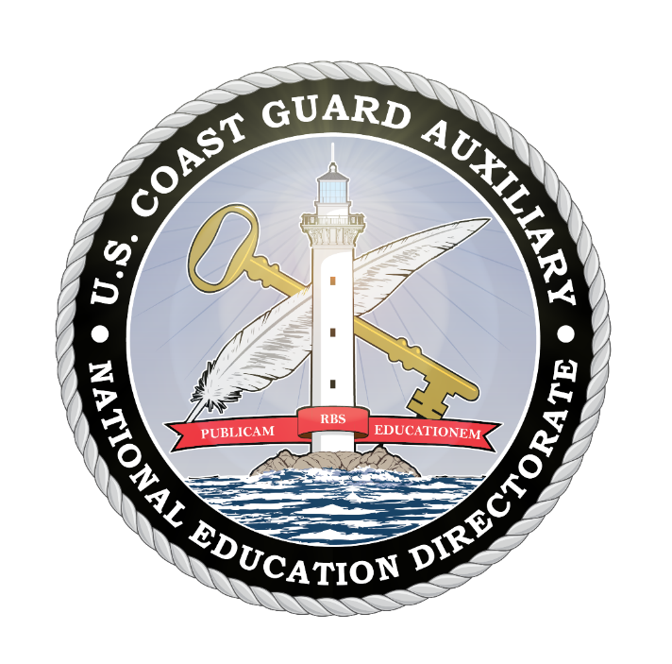
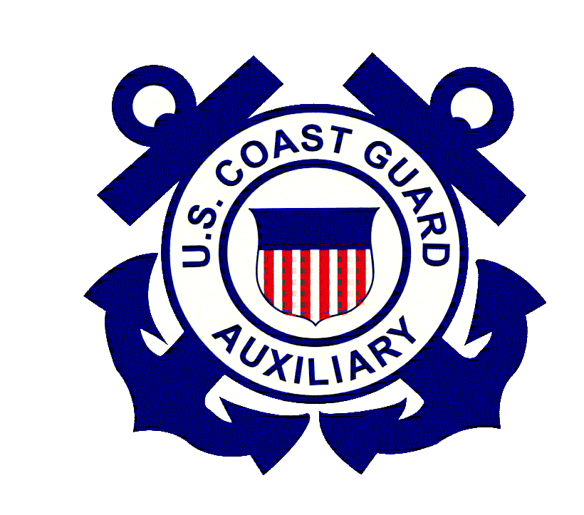
Personal Watercraft PWC Safety Having A Fun and Safe Experience
July 2023
Notes:
Many people have fun operating a personal watercraft (PWC). But people must understand that a PWC is a high-performance vessel, not a toy. Remember: not following safety precautions and courtesy on the water can quickly spell disaster for the PWC operator, passengers, and people around them.
This presentation was created to familiarize you with PWC rules and safety tips before operating a PWC. For the operator’s safety and the safety of others, we encourage the students to learn from this material, apply the knowledge gained, and ask questions about topics they don’t completely understand.
Many important points are going to be covered in this session. Here are some takeaways:
Always wear a life jacket
Attach the engine cut-off switch lanyard to you, your clothing, or your life jacket
There are no brakes on a PWC
Pay attention to what is going on around you
Keep plenty of distance between you and others
Operate at a safe speed
You can be responsible and still have fun!
NOTE: Reference to any specific commercial product, process, or service, or the use of any trade, firm, or corporation name is for the information and convenience of the public and does not constitute an endorsement, recommendation, or favoring by the U.S. Coast Guard or Coast Guard Auxiliary. Most photos are from copyright and royalty sites like Unsplash and Pexels. Instructors should be aware that the videos included in this presentation are links and require Internet access to play.

Slide 2
Learning Objectives
Introduction
PWC Operations
Preparing to Get Underway
Maneuvering and PWC Handling

Slide 3
Learning Objectives
Rules of the Road/Federal Regulations and Laws
Navigational Aids
Safety and Risk Management
Summary
Q & A

Slide 4
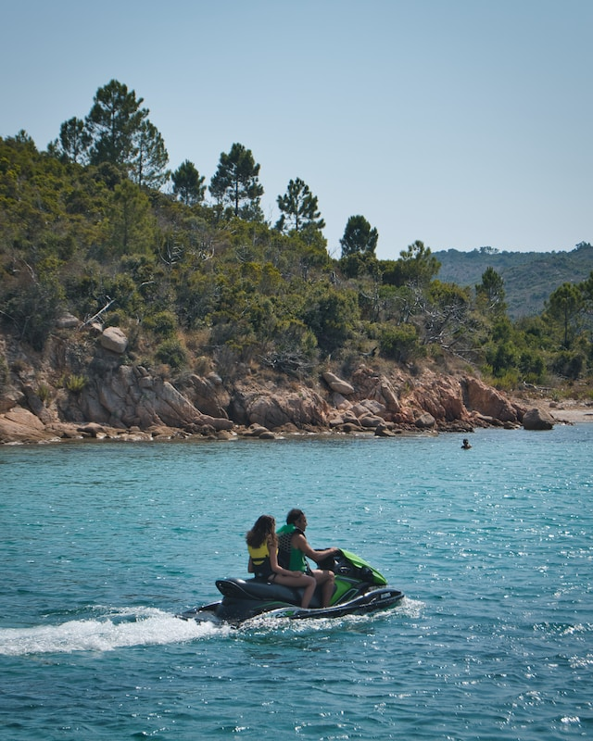
Personal Watercraft Operation
Notes:
As the operator, you are always responsible for the safe operation of your PWC. Don’t forget that you are responsible for complying with the navigation rules and posted speed regulations. Stay alert. Keep a proper lookout. Operate your PWC at a safe speed and distance. Take all necessary actions to avoid collisions. Give way or yield to other vessels when required.
The most common causes of PWC accidents are careless operation, inattention, operator inexperience, and no proper lookout.
Careless activities such as wake jumping, spraying other boaters, riding too fast and too close, as well as similar activities can lead to serious injury or death. These are not only unsafe, but they are also against the law.
To avoid being involved in an accident, be sure to keep an eye on what’s happening around you – situational awareness – slow down a little, and use good judgment. You are always responsible for the safe operation of your PWC.
Always be courteous and respectful of other people and the environment. It’s important that wildlife and our natural resources aren’t adversely affected by your use of the waterway. When operating close to shore where your PWC could disrupt other people enjoying the outdoors or wildlife in the area, slow down, minimize your disturbance, and select a less disruptive area to enjoy your PWC ride.
Bottom line: if you’re likely to disturb others, find another place to ride.

Slide 5
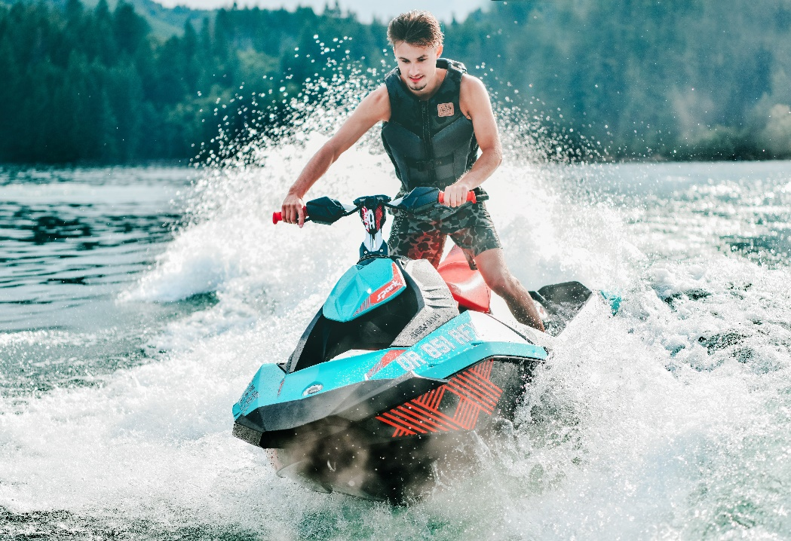
Personal Watercraft (PWC)
Jet-propelled watercraft come in many sizes
Most common jet-propelled watercraft for recreational boaters
Considered a “Class A” powerboat
Powerful, fast, and very maneuverable
Notes:
A PWC Operator is a BOATER! All PWCs are officially considered powerboats (“Class A” Inboard Boats) by the US Coast Guard. Under the law, they have the same requirements for registration and regulations as all other power boats.
All PWCs are powered by a jet-drive propulsion system that pumps large quantities of water. The jet pump works by drawing water into the housing ahead of an impeller. The impeller is a type of precision propeller contained within the housing that pressurizes the water as it enters and forces the water toward the stern of the PWC. The water enters through a grate and then exits through a smaller, round nozzle. The principle of water entering a smaller orifice is the basic operating principle of a jet pump. The force of the exiting water is what pushes the PWC in the opposite direction.
When around docks and piers, PWC pros are in complete control of their vessel at all times, and that allows them to use primarily idle power and move slowly to where they want to be. Any power above idle, “gunning it” to maneuver, can put you in a difficult position. Sometimes you may need to give short bursts of power to maneuver, but operating at high speeds in close quarters isn’t safe. It’s almost impossible to correct excessive speed and most likely will result in a collision. “Slow is Pro.” Do it like the professionals.
Like it or not, you have the power, speed, weight, and maneuverability to injure others severely.

Slide 6
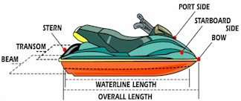
Personal Watercraft (PWC)
Parts of a PWC
Notes:
Knowing the following boat terms will help you understand the basics of some of the boating terminology used throughout this session. Not all terms are illustrated on the slide.
Port – the left side of a PWC when aboard and facing the bow (left is four letters, and so is port – a handy memory tool).
Starboard – the right side of the boat when aboard and facing the bow.
Bow – the front of the PWC
Stern – the back of the PWC
Hull – the body of the PWC
Steering Control – the device designed for controlling the direction of the PWC
Throttle – controls speed by regulating the amount of fuel delivered to the engine
Safety Lanyard – engine shut-off cord attached to the operator and PWC.
Reverse Bucket – this is a movable bucket-shaped plate that moves down in front of the exiting jet of water. This changes the thrust of the PWC from a forward motion to a neutral or reverse motion. If the reverse bucket is moved into a position at any speed other than idle, damage to the plate and brackets can occur.
NOTE: The handlebars of a PWC control a moveable nozzle at the rear of the jet pump housing. The steering controls the direction of a high-pressure stream of water that forces the stern to the left or right. When the steering control/handlebars are turned, the movable nozzle is turned in the same direction, causing the stern of the PWC to be turned in the opposite direction.
Remember that when power is shut off, there is no power to the pump, and you will not be able to control steering.

Slide 7
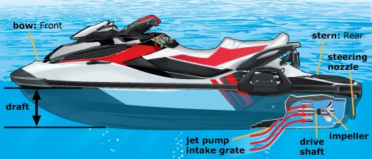
Personal Watercraft (PWC)
Notes:
Take note of the jet pump intake grate.
Keep away from this location, as well as the impeller exhaust nozzle, particularly when the engine is running. Clothing, long hair, and other objects can easily be drawn into the grate and impeller, which has resulted in drowning or other injury.
The jet nozzle will produce a water velocity that can injure you. Stay clear! The Impeller is a direct drive from the engine. When the engine is running, the impeller is spinning, drawing water (and debris) in and ejecting them out the nozzle.
Even if you are idling and have adjusted the nozzle to remain stationary, the machinery is turning, drawing water in, and ejecting it.
Never operate your PWC in water less than 24 inches. Jet drives require water deep enough so that debris and other particles will not be sucked off the bottom into the jet drive.
The PWC operator and passengers should avoid getting too close to the engine intake or the water-jet nozzle, as water-jet thrust under pressure can cause serious injuries or death. Debris, sand, or pebbles could be sucked in and discharged out of the jet nozzle at high pressure, potentially harming nearby people. Long hair, loose clothing, life jacket straps, and tow lines can also get sucked into the intake and cause injury to the person or damage to the jet drive. Operators need to be aware of persons and objects around their vessel and near the jet intake. Turn off the PWC and detach the engine cut-off switch lanyard when near people or objects in the water. Before attempting to remove debris caught in the intake, turn the engine off and remove the engine cut-off switch lanyard.
Notice how much a PWC “impeller” looks very much like a regular boat “propeller” or “prop.” Why is one called a “propeller” and the other called an “impeller”? A propeller gets “thrust” by cutting through the water. An impeller gets thrust by “propelling” or “pushing” the water through a smaller orifice.

Slide 8
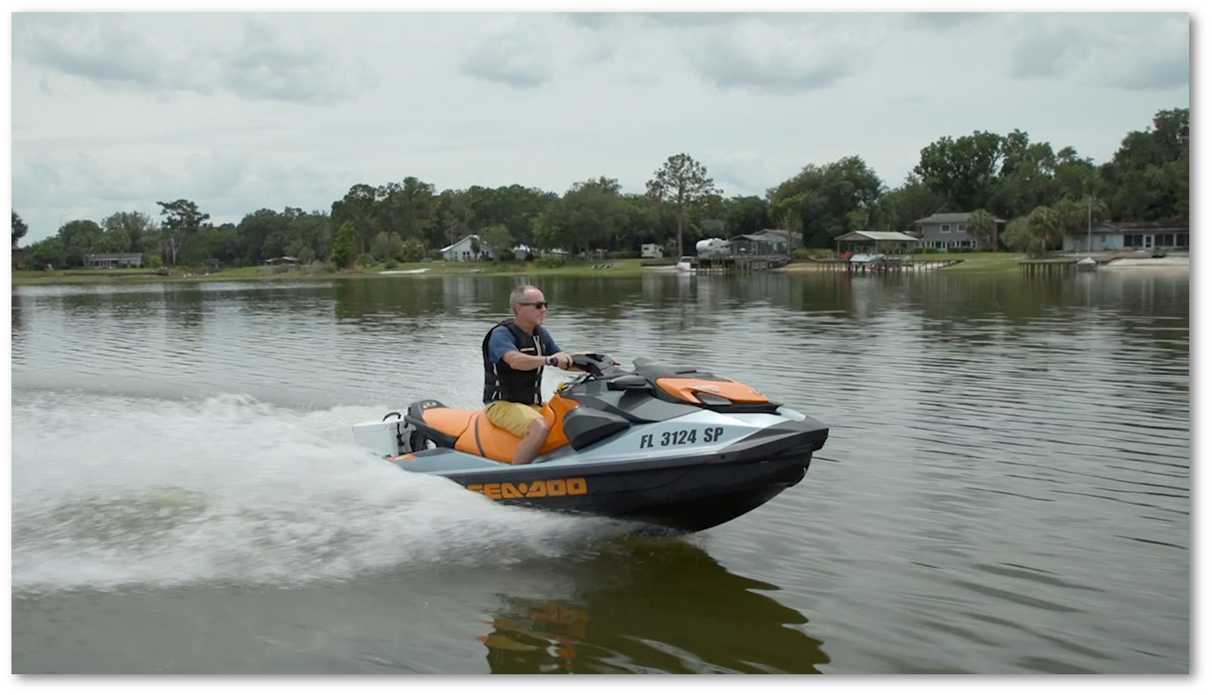
Water Safety Foundation
https://drive.google.com/file/d/1ALpm22Wt585ZOSTEIh2xg5zuCUYmF5Ig/view?usp=share_link
Notes:
This video was produced by the Orlando-based Water Safety Foundation.

Slide 9
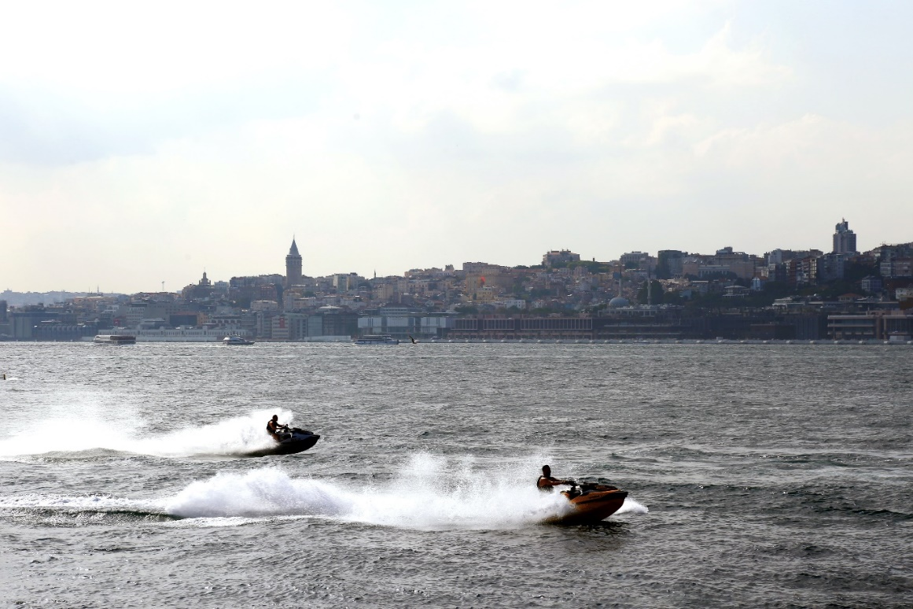
Key Points in the Video
No thrust = no maneuverability
Keep your head on a swivel
Don’t follow too closely
Practice and learn all your controls
Choose where you ride
Notes:
Ask:
So what do you think? What jumps out at you in the video [either good or bad]?
Let’s talk about it for a few minutes
Pause and allow the class to share their reactions to the video.
Lack of responsiveness or maneuverability with little or no thrust applied
No Jet thrust, no steering. If you are moving, particularly toward a fixed object, and you close the throttle, you will proceed ahead without the ability to change course.
Keep your head on a swivel. Always look before turning or any maneuver
Your PWC is extremely maneuverable; other boaters may not know that. Always look all around first.
Not following too close. Safe distance.
Although modern PWCs have a reverse thrust feature, it does not perform like brakes would. Avoid riding immediately behind any craft.
Avoid running close side to side with another PWC or watercraft
It doesn’t take much rough water or adverse winds to cause a collision
Choose where and with whom you ride to avoid setting yourself up for a mishap
Knowledge and experiences vary; select your riding partners carefully

Slide 10
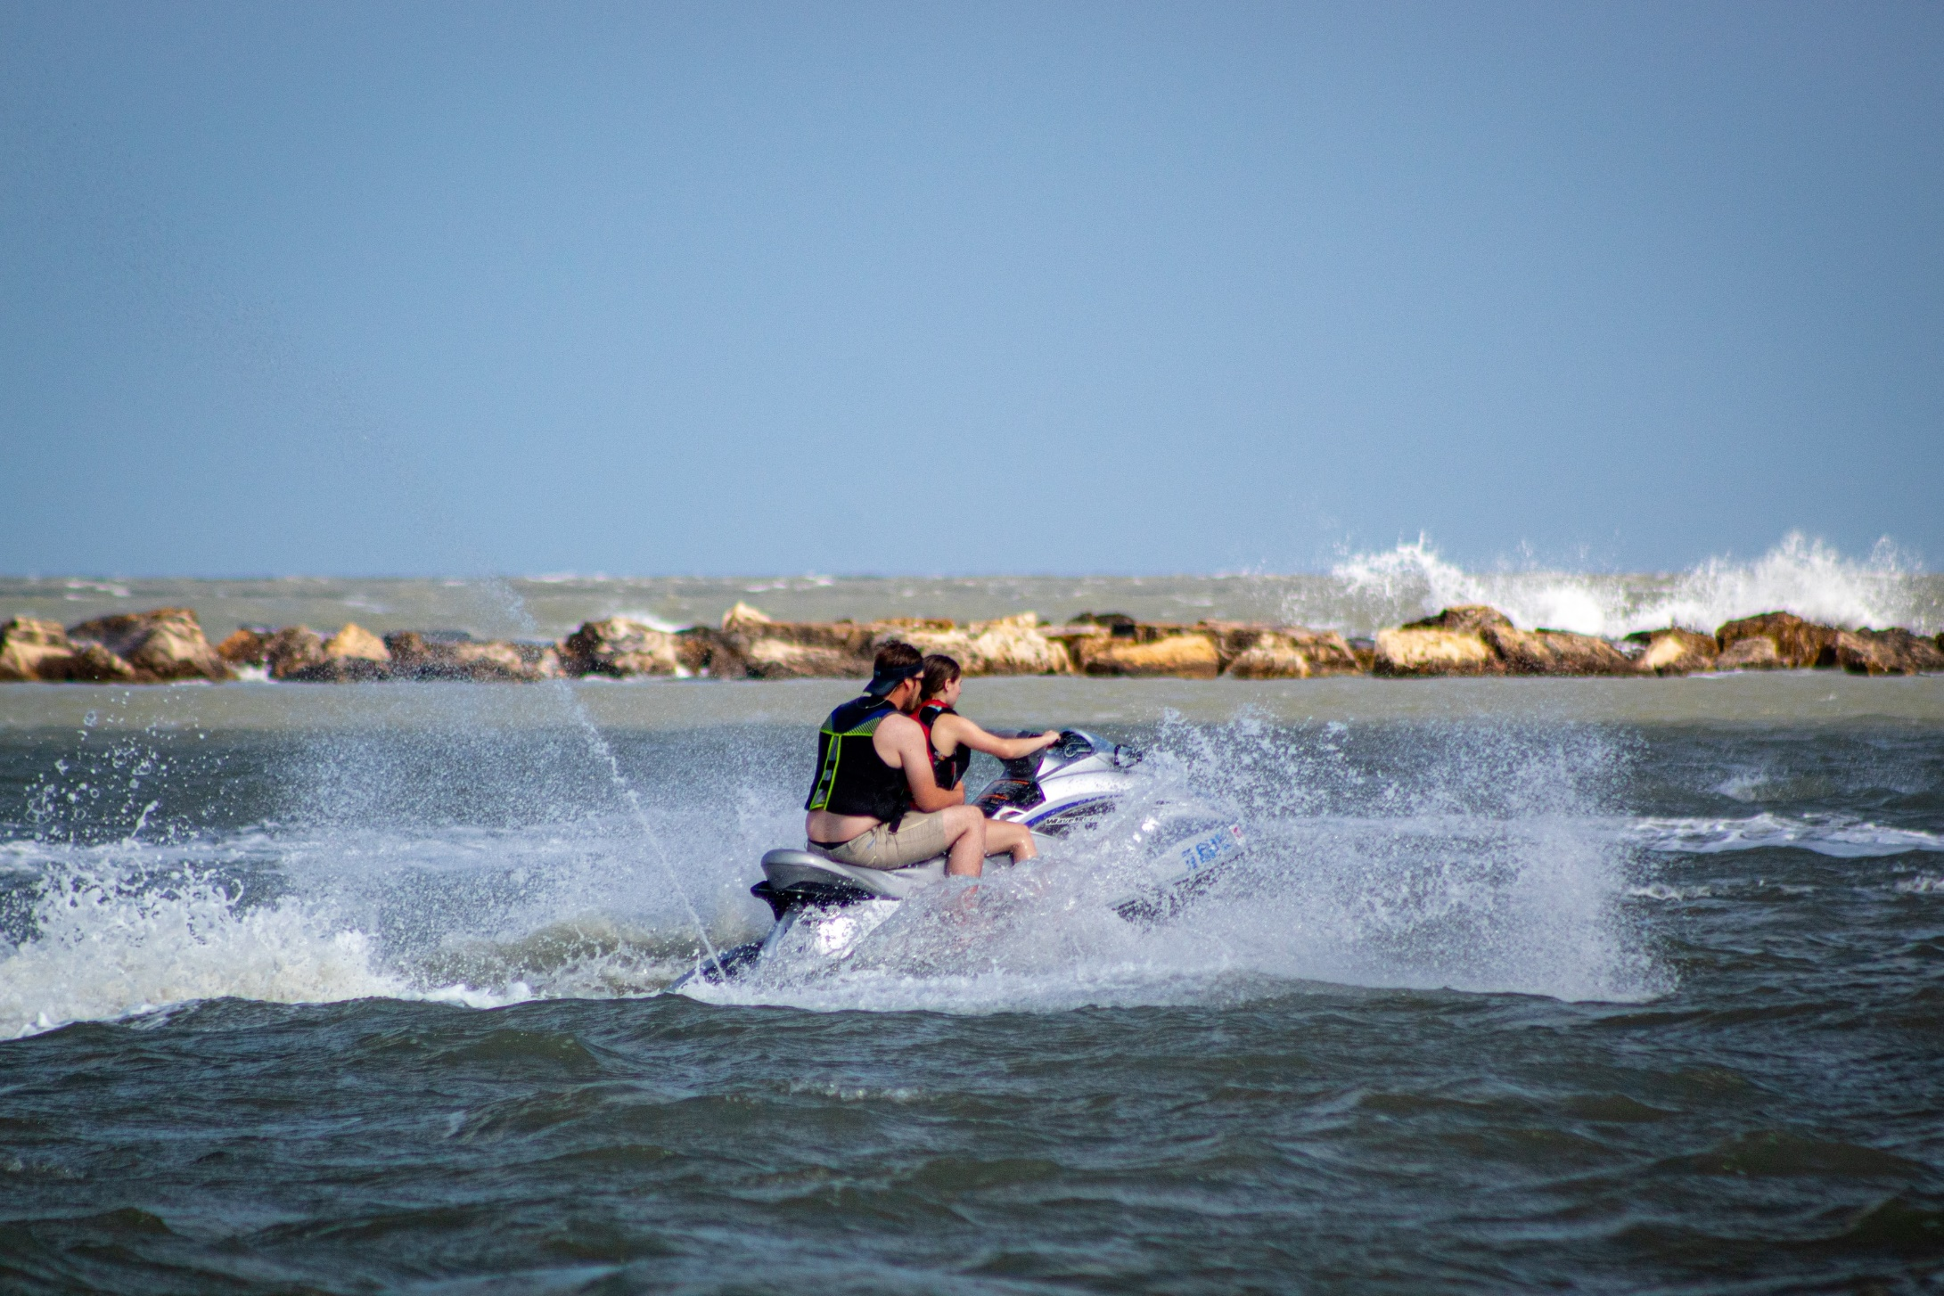
Preparing to Get Underway
Notes:
Experienced boaters, regardless of the type of boat, spend a good amount of time preparing to go out on the water. When faced with turbulent waters, high winds, or radical behavior by other boaters, that preparation pays off.

Slide 11
Preparing to Get Underway
Use a pre-departure checklist
Check the weather forecast
Check for any fuel or oil leaks
Check hose connections and clamps
Check engine battery
Check the fire extinguisher
Check the hull for cracks or loose parts
Check the steering and throttle controls
Notes:
Use a pre-departure checklist to make sure all the safety equipment and items are aboard and in working order – including the proper number of life jackets speed rated and in good condition, a waterproof marine VHF radio (or at least a cell phone in a watertight bag), a spare engine cut-off switch lanyard, goggles or other eye protection, “booties” or other suitable footwear, neoprene pants or shorts or other clothing to protect you in case you are ejected, and warm clothing layers if you’re going to boat in colder water.
Consider adding these to the items you take aboard: first aid kit, survival blanket, visual distress signals, personal locator beacon (PLB), hat or helmet, gloves, sunscreen, drinking water, and mooring lines.
Besides the items on the screen, discuss the following safe boating tips.
Check the weather. Do not operate the PWC in rough water, bad weather, or poor visibility conditions.
Check fuel levels before starting the engine. Make sure you have enough fuel to return to shore.
Perform pre-operation checks as outlined in the owner’s manual for your PWC.
Board your PWC according to manufacturer recommendations
Know your limitations and those of your PWC.

Slide 12
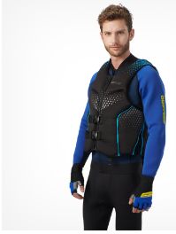
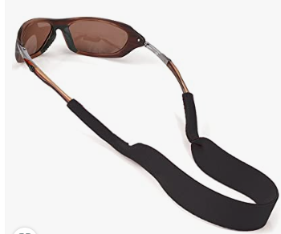
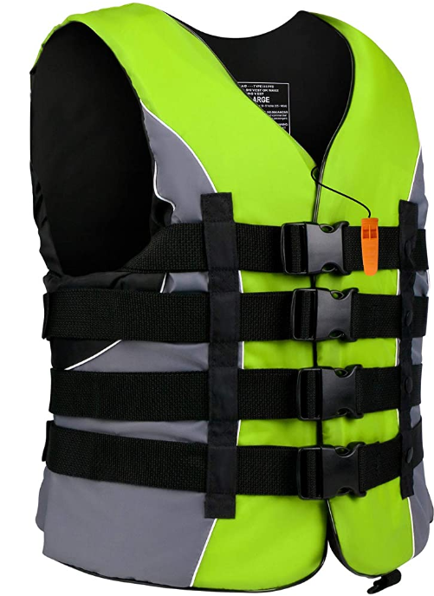
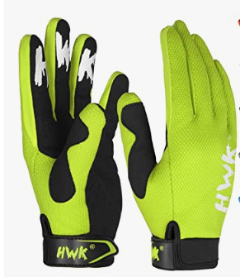
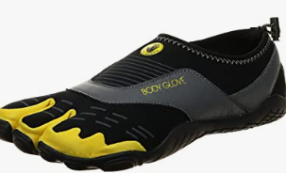
Personal Protective Equipment
Notes:
All riders must wear a life jacket that is approved by the USCG and is suitable for personal watercraft use. Especially consider high-speed impact-rated life jackets. A whistle should always be attached to the life jacket.
The personal safety of the PWC operator and any passengers is very important. This includes wearing additional Personal Protective Gear (PPE) over and above what the law requires. Some of these items are:
Goggles or sunglasses to keep wind, water, and glare from the sun out of your eyes while operating the PWC. Restraining straps for eyewear are made which are designed to float should your eyewear fall in the water.
Sunscreen
Booties or footwear
A hat or helmet (a helmet is a good practice if you’re planning on going very fast). A helmet could reduce injuries in a collision with a boat or other obstacle.
Gloves
Clothing for the water temperature
Wet suit bottom or thick, tightly woven, and snug-fitting clothing that provides equivalent protection. Severe internal injuries can occur if water is forced into body cavities as a result of falling in the water or being near the jet thrust nozzle. Normal swimwear doesn’t adequately protect against forceful entry of water into the lower male or female body openings. Riders not wearing neoprene shorts have received severe rectal, vaginal, and internal injuries. Every major PWC manufacturer’s owner’s manual states this as a requirement.
Also include a first aid kit and telescoping paddle

Slide 13
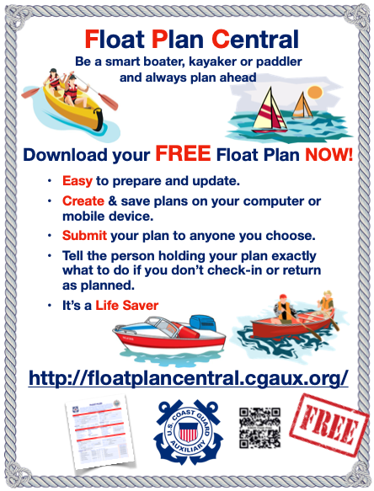
Preparing to Get Underway
Be sure the bilge plug is secure
Leave a “Float Plan”
Discuss the location of emergency equipment with any passengers
Attach the Engine Cut-Off Switch Lanyard (ECOS)
Notes:
What is a Float Plan? Call someone you trust, and tell them when you are leaving, where you are going, how you will get there (the route), when you expect to return, and the return route if it differs. Call them when you return. If you do not return on time, they need to find out why, if possible, and, if still missing, call authorities. With a Float Plan, search time by air is often about two hours along a “track line.” Without a Float Plan: An Area Search of any size would take a day, perhaps two. How long can you tread water?
Discussing emergency equipment is actually a risk management process. Every outing should include a pre-brief on these subjects, periodic updating of that brief while underway, and a “debrief” with all concerned to evaluate how you did and how you could do it better.
We will talk more about Risk Management in this presentation.
Riders must wear high-visibility clothing and add high-vis accessories to PWCs to avoid collisions with boats and aid in rescue situations. Navy blue and black colors should be avoided when purchasing a life jacket for a PWC.
Under federal law, PWC operators are required to use their engine cut-off switches (ECOS). That means wearing a lanyard—aka ECOS—while at the wheel. The ECOS lanyard must be attached to your body, life jacket, or clothing while operating a PWC. This switch shuts off the engine if you are thrown into the water and also helps make sure you can get back to your PWC and don’t get run over by it. If the ECOS does not shut off the engine when the lanyard is pulled, do not operate the PWC until it is repaired.

Slide 14
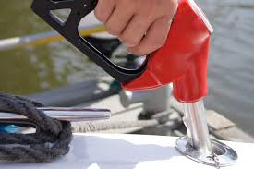
Fuel Your PWC … Safely
Check fuel system for leaks
Avoid fuel spills in or near water
Do not tip PWC to fill all the way up
Notes:
Fill the PWC tank to 90%; listen and learn to estimate when your tank is 90% full. PWCs have a built-in tank with a capacity of five to twenty gallons, depending on the manufacturer and model.
If possible, refuel on land to reduce any chance of spilling oil or gas into the water.
Slow down when filling the tank. Don’t overfill. Catch any accidental spills with an absorbent pad and dispose of it properly.
Check and clean your engine well away from shorelines. Water and oil don’t mix and can harm the water’s delicate micro-organisms and the animals who feed on them, potentially upsetting the entire food chain.
After fueling, sniff to check for gas fumes. Yes, this means lifting the seat. This is called the “sniff test.” A fully functioning vessel, including a PWC, will not have noticeable gas fumes.
IF YOU SMELL FUMES, DO NOT START IT!
You need to learn how long you can cruise in your PWC with a full gas tank and then be aware of places you can refuel. Our waterways don’t have gas stations on every corner like we have on our highways. Many older type PWCs, like many motorcycles, are equipped with a three-way switch that controls the gas tank: off, on, and reserve. As you start to run low on fuel, you can turn the switch to reserve to give you a little more time to find a place to fuel up or to return to the boat ramp.
An average PWC uses three to four gallons of gas per hour at the best cruise (most fuel-efficient) speed. If you ride it hard, a PWC can use 10-25 gallons of gas every single hour!

Slide 15
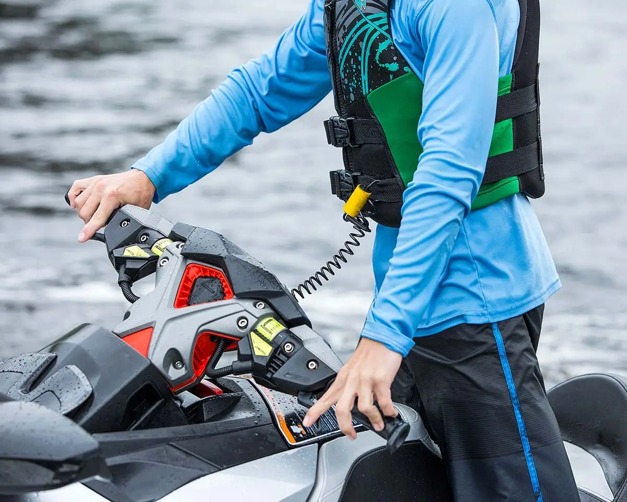
Engine Cut-Off Switch (ECOS)
Safety switch
Lanyard
Self-circling feature
Notes:
Under a federal law effective April 1, 2021, those piloting boats less than 26 feet in length are required to use their engine cut-off switches (ECOS) much of the time. That means wearing a lanyard—aka ECOS—while at the wheel. (Formerly referred to as a “kill switch,” the term engine cut-off switch, or ECOS, is the preferred nomenclature, whether referring to engine-cut-off switches operated by a physical lanyard or any of several electronic solutions.)
The PWC ignition safety switch (ECOS) lanyard must be attached to your body, life jacket, or clothing while operating a PWC. This switch shuts off the engine if you are thrown into the water and also helps make sure you can get back to your PWC and don’t get run over by it. If the ECOS does not shut off the engine when the lanyard is pulled, do not operate the PWC until it is repaired.
It is important to take along a spare lanyard and PWC key. Without them, you may not be getting home any time soon.
Your PWC may have a self-circling feature. If the operator is thrown from the PWC, the engine idles while the PWC slowly circles so that the operator can reboard.

Slide 16
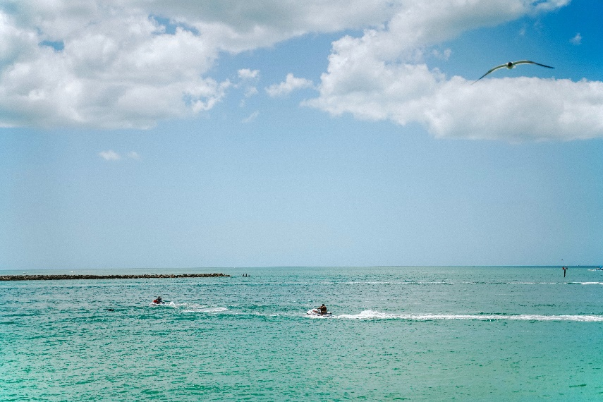
Letting Someone Else Use Your PWC
They Need To:
Take first rides in an uncrowded place
Learn how to steer and control the PWC
Use the engine cut-off switch (ECOS)
Understand speed restrictions
Always keep a proper lookout
You are responsible for their actions, and they need to be trained and capable.
Notes:
You would not hand the keys to the family car over to another person without knowing if they would safely operate it. If you permit a friend to operate your PWC, you are responsible for what they do. Ensure they know the rules and can safely operate the PWC. It’s probably better to take them for a ride yourself and help them learn how.
Make sure you know what the minimum age for the operation of a PWC is in your state. State requirements vary widely. Regardless, the PWC operator should have the physical ability and maturity to drive a powerful and fast vessel. This also includes knowing how to swim and reboard the PWC from the water.
Even though others are using your PWC, it is still yours, and you remain responsible for any potential outcome, possibly including collisions and injuries. You are the person whose name is on the registration and probably the insurance policy.
Some newer PWCs have a learning key that limits the PWC’s performance and may be ideal when lending your PWC to another operator.

Slide 17
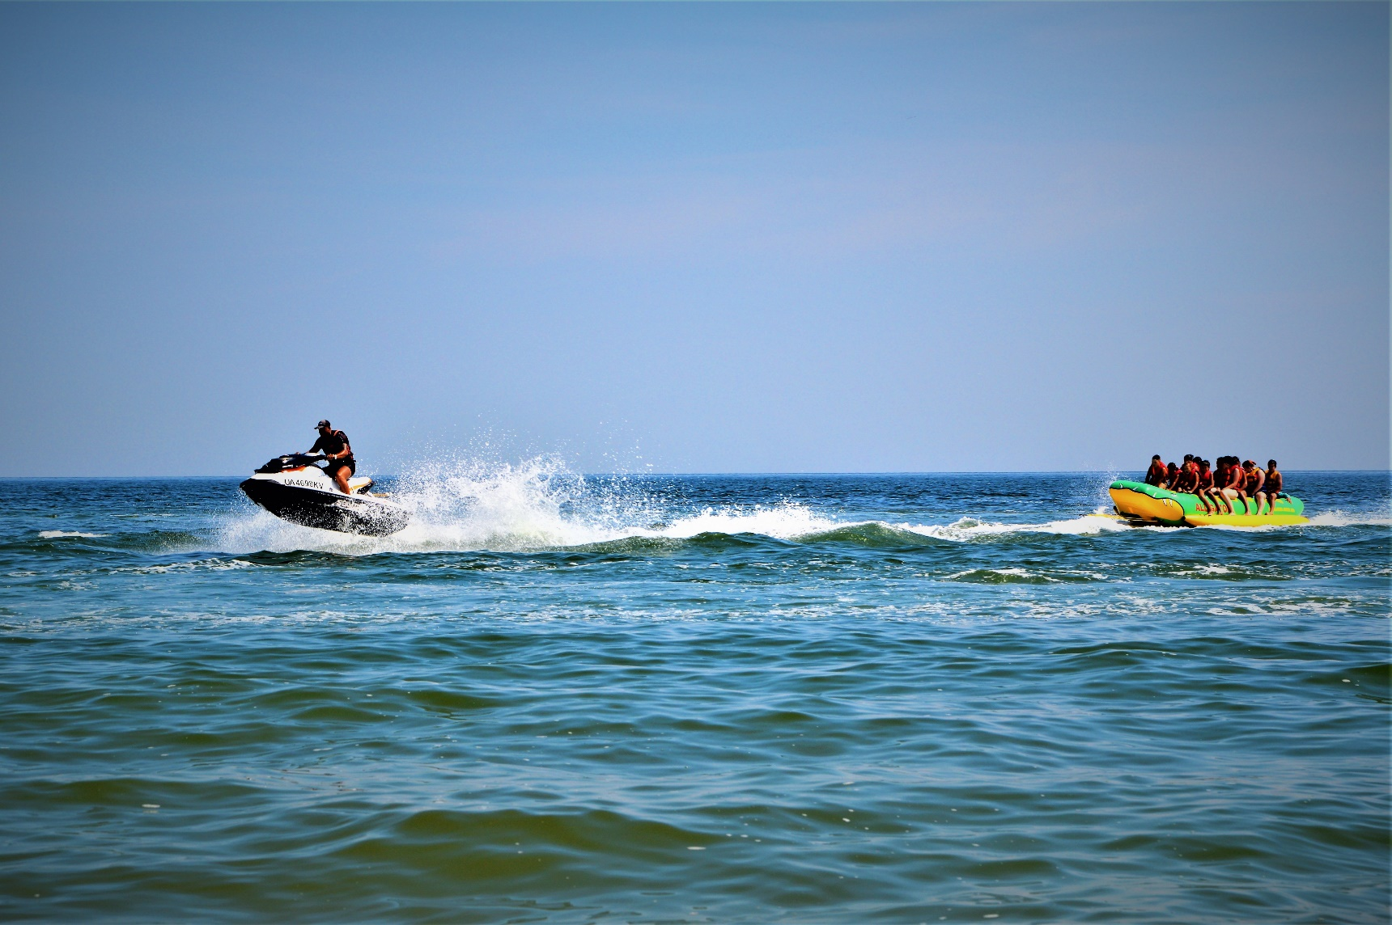
Getting Underway
Stay aware of others in or on the water
Control the noise of your PWC
Dress for the water
Notes:
Constantly look around; rotate your head and keep an eye on everything around you. Always know what’s going on around your PWC. Most boating accidents involve collisions with other vessels or fixed objects (docks, markers, bridge pilings, etc.). Scan constantly while operating your vessel and maintain 360⁰ awareness on the water.
Far away to a lesser degree and close to you with great attention. Figure out where they are going and avoid getting too close. If they are steering erratically or changing speeds regularly, steer away from them into safer waters.
This is often referred to as “situational awareness.” Always keep your head in the game and avoid dangerous situations.
Do not operate your PWC recklessly.
Remember that staying alert is one of the most critical parts of boating.
The noise caused by a PWC is one of the most common complaints among the public and one of the major reasons cited for regulating PWC activity. Avoid riding close to shoreline homes and wildlife areas. Keep a respectful distance from fishermen, other boats, swimmers, and populated beaches. When travel in these areas is unavoidable, ride slowly and obey all laws.

Slide 18
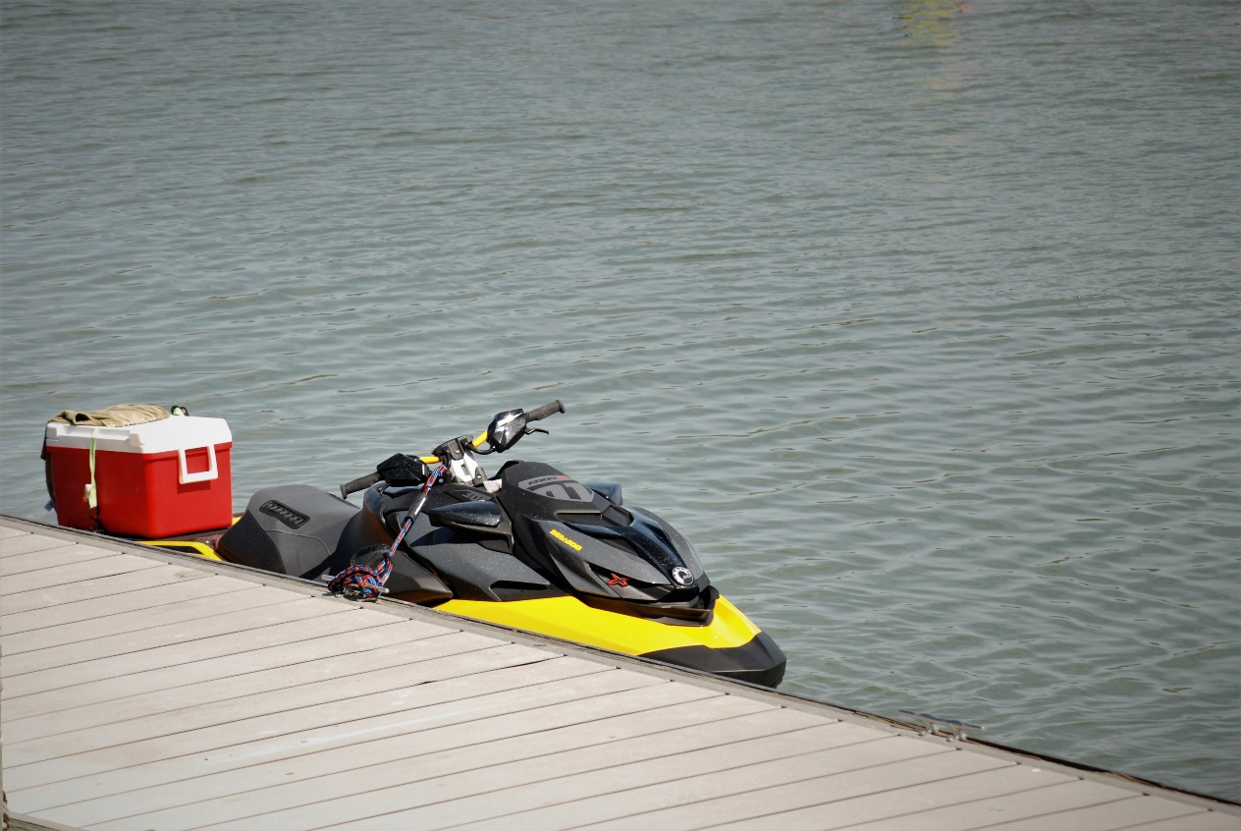
Casting Off
Before casting off:
Keep the PWC tied to the dock or pier while the engine warms up
Ensure everyone is wearing a life jacket
Hook up the engine cut-off switch lanyard (ECOS)
Notes:
Make certain that your engine is “warmed up” and running smoothly before you untie lines. You are going to want the control your engine gives you once you are no longer moored.
Lines should be removed from bow eyes and other cleats to avoid fouled impellers.
Always wear a US Coast Guard-approved life jacket. It’s the law! The primary cause of death in boating accidents is drowning. Nearly all of those could be prevented by wearing a life jacket. Since PWCs can go fast (some models can even go 70 mph), make sure you’re wearing a high-speed impact life jacket, typically 100 mph.
Both the operator and passengers should wear water shoes to help protect the feet from objects hidden under water. Wearing gloves can also help protect your hands from abrasions.
Because of the hazards of the impeller and jet wash, PWCs should be turned off, and the engine cut-off lanyard detached when boarding or disembarking from the vessel. In addition, PWCs may be difficult for passengers to board when not docked or moored. Reboarding can be a strenuous activity. A suitable method of reboarding should be provided, or PWC operators and passengers should practice reboarding to ensure they can be successful in deep water.

Slide 19
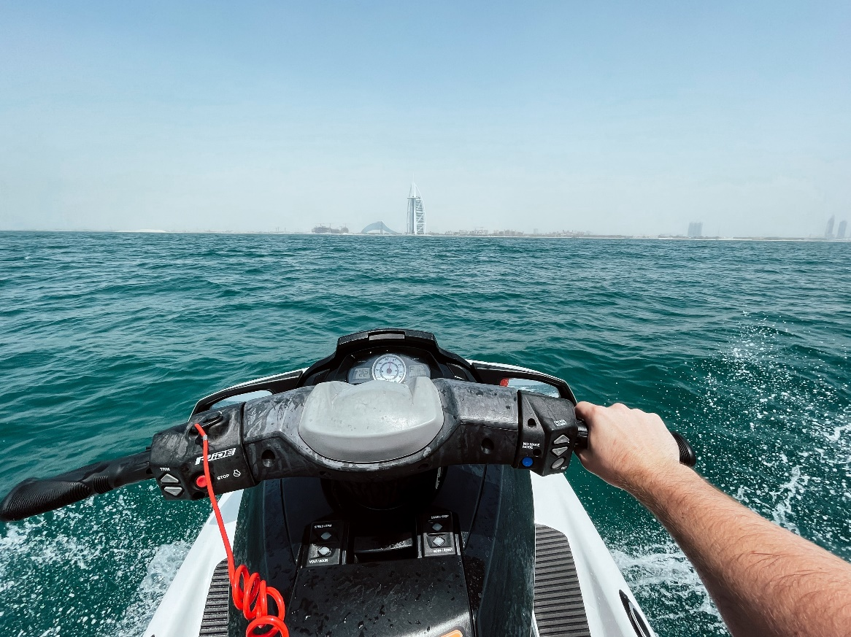
Leaving the Dock, Pier, or Beach
Look around first – all clear?
Make sure the water is deep enough
Release any lines
Use short bursts of the throttle
Pull away slowly
Notes:
After warming up the engine and before throwing off the lines, look around to make sure it’s all clear to leave the dock.
Every PWC is manufactured differently. Always consult the owner's manual for specific operating details. PWCs require that the engine cut-off switch be engaged before the engine will start. If the engine does not start, check to ensure the cut-off switch is in the run position.
Be sure that there is no one behind the jet nozzle or near the intake at start-up. When the engine is started, water will immediately begin to be sucked in and exit the nozzle. This will also cause the vessel to move at a slow speed.
Always avoid starting up your PWC in shallow water, as this can cause the intake to become clogged with pebbles, algae, sand, and other debris. Pull away from the dock slowly and carefully to avoid hitting anyone or anything, and only speed up when you’ve reached open water that’s relatively free of obstacles. Twist that throttle again, and have a great time!
We’ll discuss operating your PWC and having fun on the water later in this session.

Slide 20
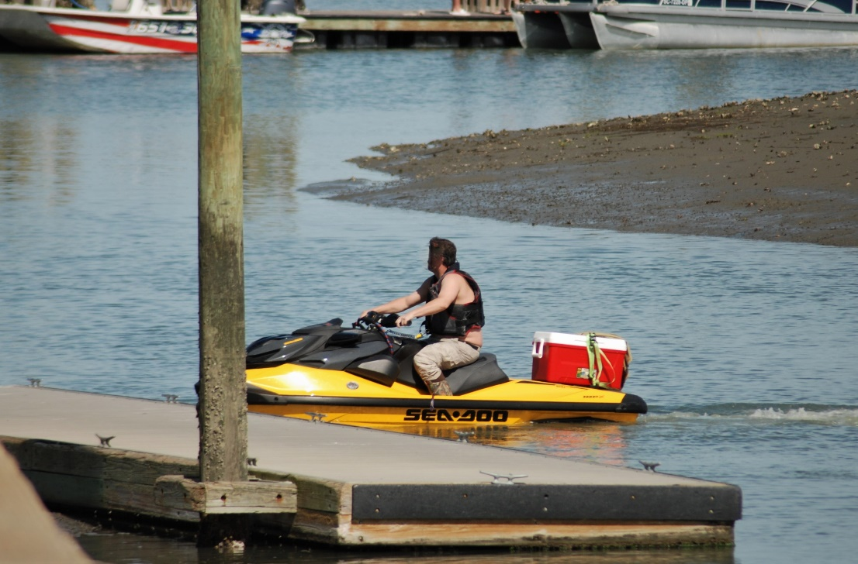
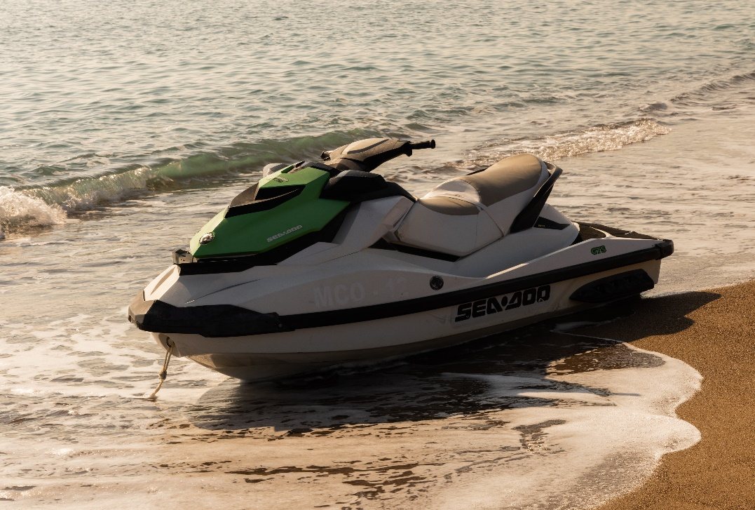
Docking, Mooring, and Beaching a PWC
Study the situation – all clear?
Approach slowly
Use short bursts of throttle for control
Beaching – turn off in deeper water and walk to the beach
Watch Video
Notes:
A PWC needs to have some amount of throttle applied to enable steering. Refer to your owner's manual for using off-throttle steering, braking, or reverse systems that may be utilized on your PWC to help with docking procedures.
PWCs should not be operated in shallow water to avoid damage to the drive system from debris sucked up into the system and to avoid damaging the environment. To beach a PWC, the vessel should be turned off well away from the shore and walked to the beach.
Apply controlled thrust to maintain proper control and maneuverability of the PWC. Pulsing the throttle assists with turning at low speeds.
Braking capabilities can vary widely in different PWCs. Braking occurs when thrust is redirected or mechanically blocked when placing the vessel in reverse. Check the owner's manual to determine if your PWC has braking capabilities. PWCs may go a long distance before coming to a stop, so operators need to be aware of this potential hazard. When braking, make sure no one is traveling directly behind you.
PWCs are normally very limited in reverse. If so equipped, when operating in reverse, the handling of the PWC becomes sluggish. Operators should shift into reverse only when the forward speed is minimal. Refer to your owner’s manual to learn more about your PWC’s capabilities in reverse.

Slide 21
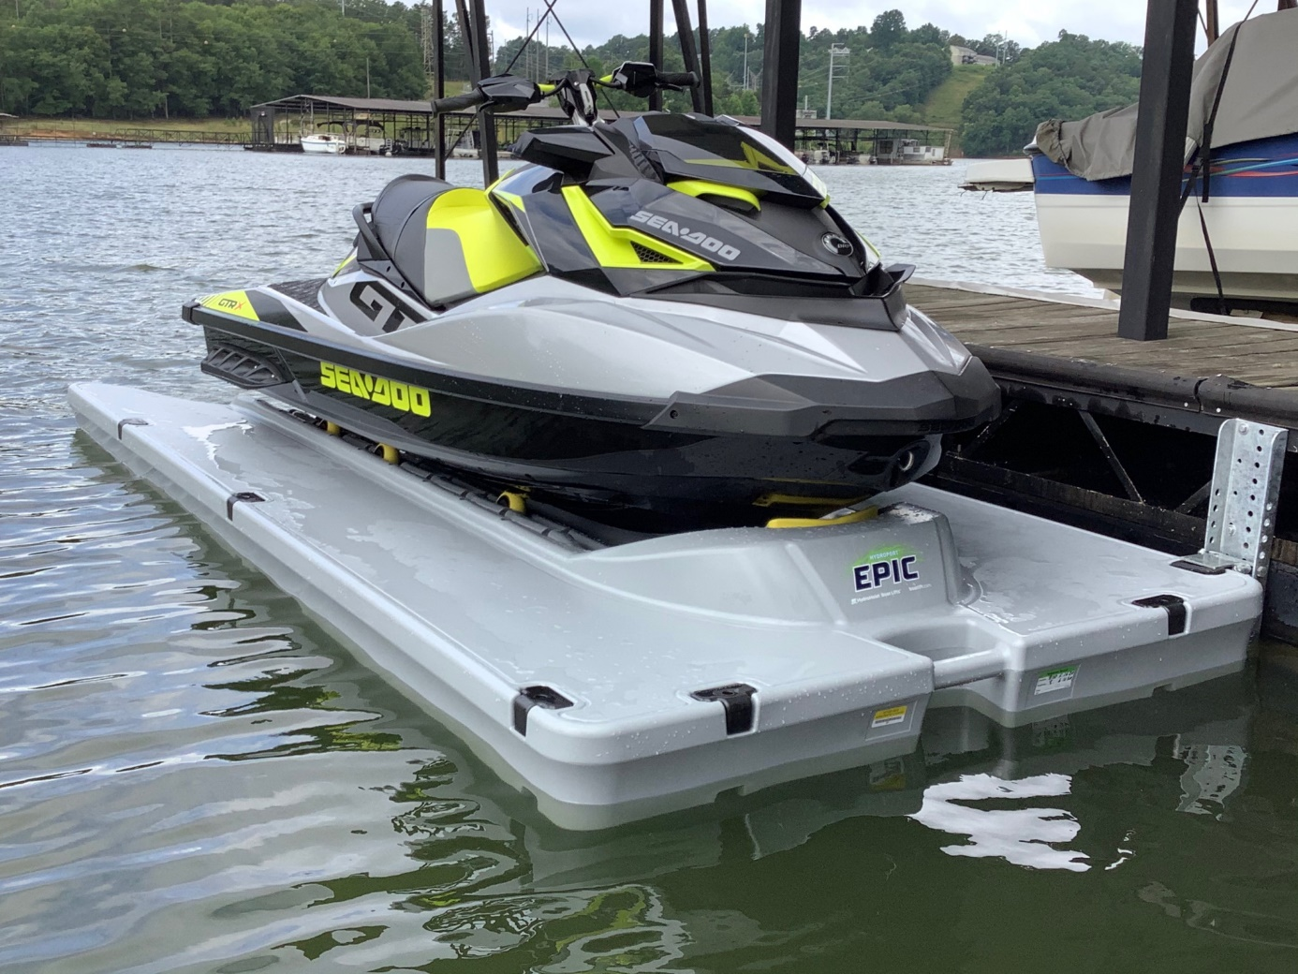
Docking on a Docking Platform
Study the situation – all clear?
Approach slowly
Use short bursts of the throttle for control
Practice, Practice, Practice
Notes:
PWC docks, also called drive-on docks, are like parking ramps designed especially for the size and weight of your PWC. You simply pull up to the dock and pause, then drive on up. A system of rollers and/or blocks accepts the weight of the PWC gracefully.
Smooth docking has a learning curve. You might want to dedicate some time to learning how to do it well. If someone else is using your PWC, we recommend that you take over the controls for docking on a platform unless they are experienced with this method of docking.

Slide 22
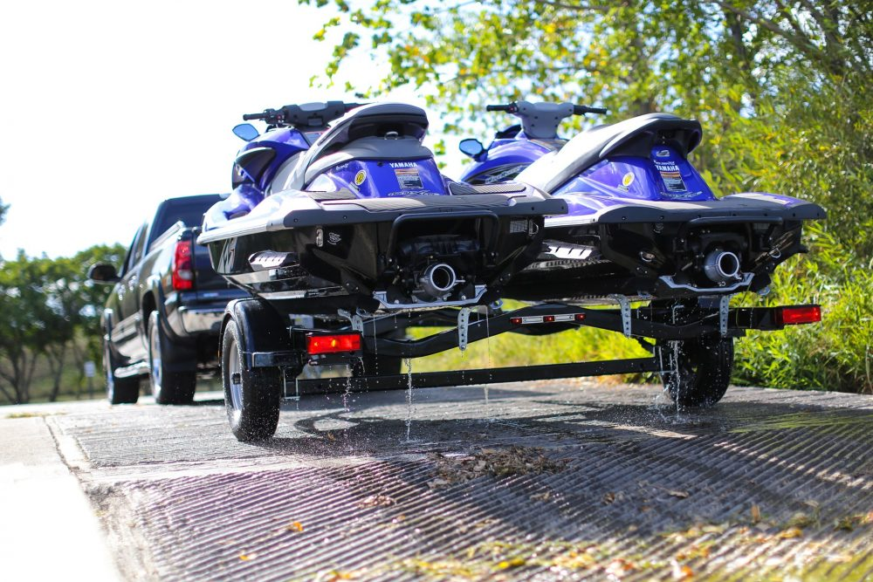
Launching From a Boat Ramp
Prepare the PWC in a staging area
Wait your turn at the boat ramp
Back down, launch, tie up, and move your vehicle
Practice, Practice, Practice
https://www.youtube.com/watch?v=ElJztB3xlas
Notes:
Launching your PWC can be an exhilarating yet daunting experience – especially the first time. Unfortunately, a significant number of PWC accidents occur in congested docks. Here are basic tips on safely launching your PWC from your trailer and preventing accidents.
Busy ramps require an efficient launch. Ensure you are proficient at backing up your trailer. If not, some practice in an open parking lot will make your experience at the ramp so much easier. As you near the ramp, remove the rear tie-downs, which attach your PWC to your trailer (leaving the front winch strap on), and remember to insert the drain plugs in to prevent water from entering the hull.
With that done, you’re ready to position your trailer so it runs straight with the ramp. As PWCs are smaller than boats, it’s a good idea to open your vehicle door so you can guide your trailer safely down the ramp. Proceed slowly and stop the vehicle before your trailer’s tires touch the water. Put your vehicle in park, and put your hand brake on before exiting the vehicle. Undo the winch strap and continue backing up until the PWC floats off the trailer of its own accord. You may have to get out and give the PWC a little push to get it going.
Once your PWC is completely afloat, jump aboard and start the engine. Ride your PWC to the closest and safest place to secure a short line. A short line can really come in handy, as there is no possibility of it being sucked up into the PWC’s pump. And, as you know, nothing can ruin your weekend quite like an expensive repair bill. With your PWC safely secured, you can head back to the ramp to park your vehicle. While most people at the dock will understand that launching a PWC is a time-consuming process, don’t dally. They’re all as anxious as you are to get out on the water.

Slide 23
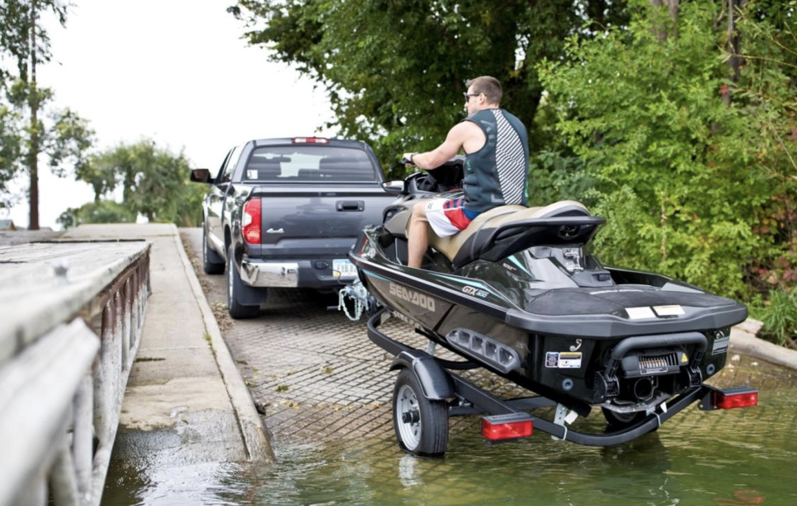
Reloading the Trailer at a Boat Ramp
Wait for an available ramp
Tie up the PWC
Back the vehicle and trailer down the ramp
Untie the PWC; slowly drive onto the trailer
Pull away from the ramp
Notes:
No PWC ride is over without reloading your PWC back on your trailer. Properly securing your PWC back on its trailer makes for a safer towing home. Back in as far as you can without submerging the rear tire bearings or axles of your tow vehicle. Put it in park. And leave it running during the entire reloading process so that water doesn’t flow into the exhaust pipe.
With the trailer in place and ready to be loaded, line up the PWC centered on the bunks or the rollers. Then drive on slowly until you’re sure the bow is properly aligned. Use the throttle to give it enough gas to seat it forward in the bunk. As soon as the PWC is far enough forward, turn it off. If driving on to the trailer is not permitted at your boat ramp, attach mooring lines and slowly float the PWC onto the trailer.
If you’re reloading alone, this is where you have to get off the PWC to hook the front up to the trailer. If you have an additional person at the trailer, the operator can stay in place aboard the PWC.
The person doing the trailer hook-up should pull out the winch strap far enough to reach the metal eye on the PWC bow. The winch strap should go between the two metal sides that the roller is mounted to. Then it goes under the roller to hold the strap in place between the metal sides during towing. Ensure that the safety snap on the hook is fully closed. Once hooked up, crank the winch handle to pull the PWC as far forward as possible, preferably tight to the roller. Then flip the winch lever closed to lock it against the winch teeth.
Get back in your tow vehicle and release the parking brake. Now pull the reloaded trailer out of the water and up the ramp slowly. Going slow will enable you to watch your load carefully to ensure your PWC is properly seated and secured. You can drain your PWC using the downward angle of the ramp to help. But only if there’s no lineup for the ramp. Just loosen the drain plugs while the back of the trailer is out of the water but angled down the ramp.

Slide 24
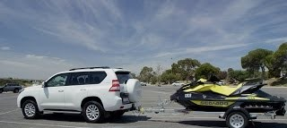
Reloading the Trailer at a Boat Ramp
Tie down the PWC to the trailer
Remove all gear that could blow off
Double check how it’s riding
Notes:
For the final reloading steps, drive slowly clear of the ramp to an area where you’re not in anyone’s way. At this time, you need to
Tie down the rear of the personal watercraft to the trailer.
Replug the trailer’s electrical hook-up into your tow vehicle.
Remove all gear that doesn’t need to stay in your PWC, so it doesn’t blow off on the road.
Clean off the outer surfaces of the PWC.
Do a complete visual check-over, looking for anything out of the ordinary that needs attention before your next ride.
Cover the watercraft and make sure the cover is properly secured to it won’t blow off or tear in transit.
One final tip. Your PWC may shift or settle slightly from the motion of starting to tow. So it’s always a good idea to stop and check that your tie-downs are still tight after trailering for 10 or 15 minutes. This is also an excellent opportunity to do a quick double-check. Do a walk-around inspection to ensure everything looks okay to continue trailering. If so, you’re good to go. And ready to launch for your next PWC excursion.

Slide 25
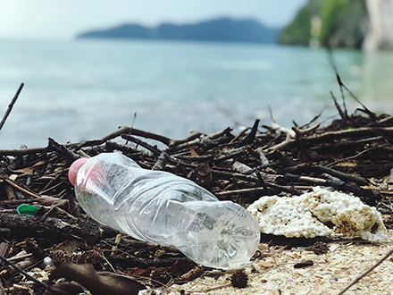
Caring for the Environment
Keep hold of your trash
Prevent the spread of aquatic nuisance species
Use the proper cleaners on your PWC
Notes:
Be careful that nothing blows off your PWC while you’re out riding or trailering. Place water bottles, food packaging, and other items in the storage compartment in the front of the PWC and dispose of them properly on land.
To prevent the spread of aquatic nuisance species, avoid traveling through vegetation with your PWC (the vegetation can also clog your intake vent). Remove all visible aquatic vegetation from PWC, anchor, lines, and trailer before leaving any body of water. Drain live wells and bait buckets into suitable containers before leaving the site.
Keeping your PWC clean and looking good isn’t just a matter of pure vanity; it’s also an important part of basic maintenance—knowing how to clean a PWC is imperative. It extends the useful lifespan of your PWC and improves functionality in many cases. The hull of your PWC is under constant exposure to the elements. Given enough time, water and sunlight can degrade the gel coat of your hull, leading to corrosion and browning.
Luckily, regular cleaning can protect and restore your hull. Avoid using abrasive cleaners, such as bleach or ammonia, which can weaken the hull or cause dangerous chemical reactions. For the best results, use marine products specific to your hull material and coat – including cleaners, protectants, and degreasers. By following the directions of each product to clean according to mixture recommendations, you can make sure your hull gleams out on the water. You can use alternative cleaning products such as baking soda, vinegar, lemon juice, and borax - and don't forget about the power of “elbow grease.” If you use detergents, use phosphate-free, bio-degradable, and non-toxic cleaners sparingly to minimize the amount discharged into the water.

Slide 26
Review
What is a Float Plan?
What is the ECOS?
What is meant by a “sniff test?”
What is an intake?
What should you do before attempting to remove debris caught in the intake?
Notes:
Float Plan: Simply contact a person you know and trust; tell them where you are going, your route, your return route if it differs, and the estimated time. If you do not return on time, your friend needs to contact officials.
ECOS: If attached to you and the PWC properly, the Engine Cut-Off Switch will shut off the engine if you fall off or are otherwise no longer onboard and in control. It will prevent your PWC from traveling away without you and prevent it from circling around and injuring you or your passengers. Wearing the ECOS is the law!
Sniff Test: Gas fumes in your bilges are an explosive hazard. Before starting the PWC, particularly after refueling, you should check for gasoline fumes by “sniffing” the interior (engine compartment and bilges). If you smell gasoline fumes, do not attempt to start the engine.
Intake: The opening in the hull through which water is pulled into the impeller of the jet drive.
Removing Debris: Turn the engine off and remove the engine cut-off switch lanyard.

Slide 27
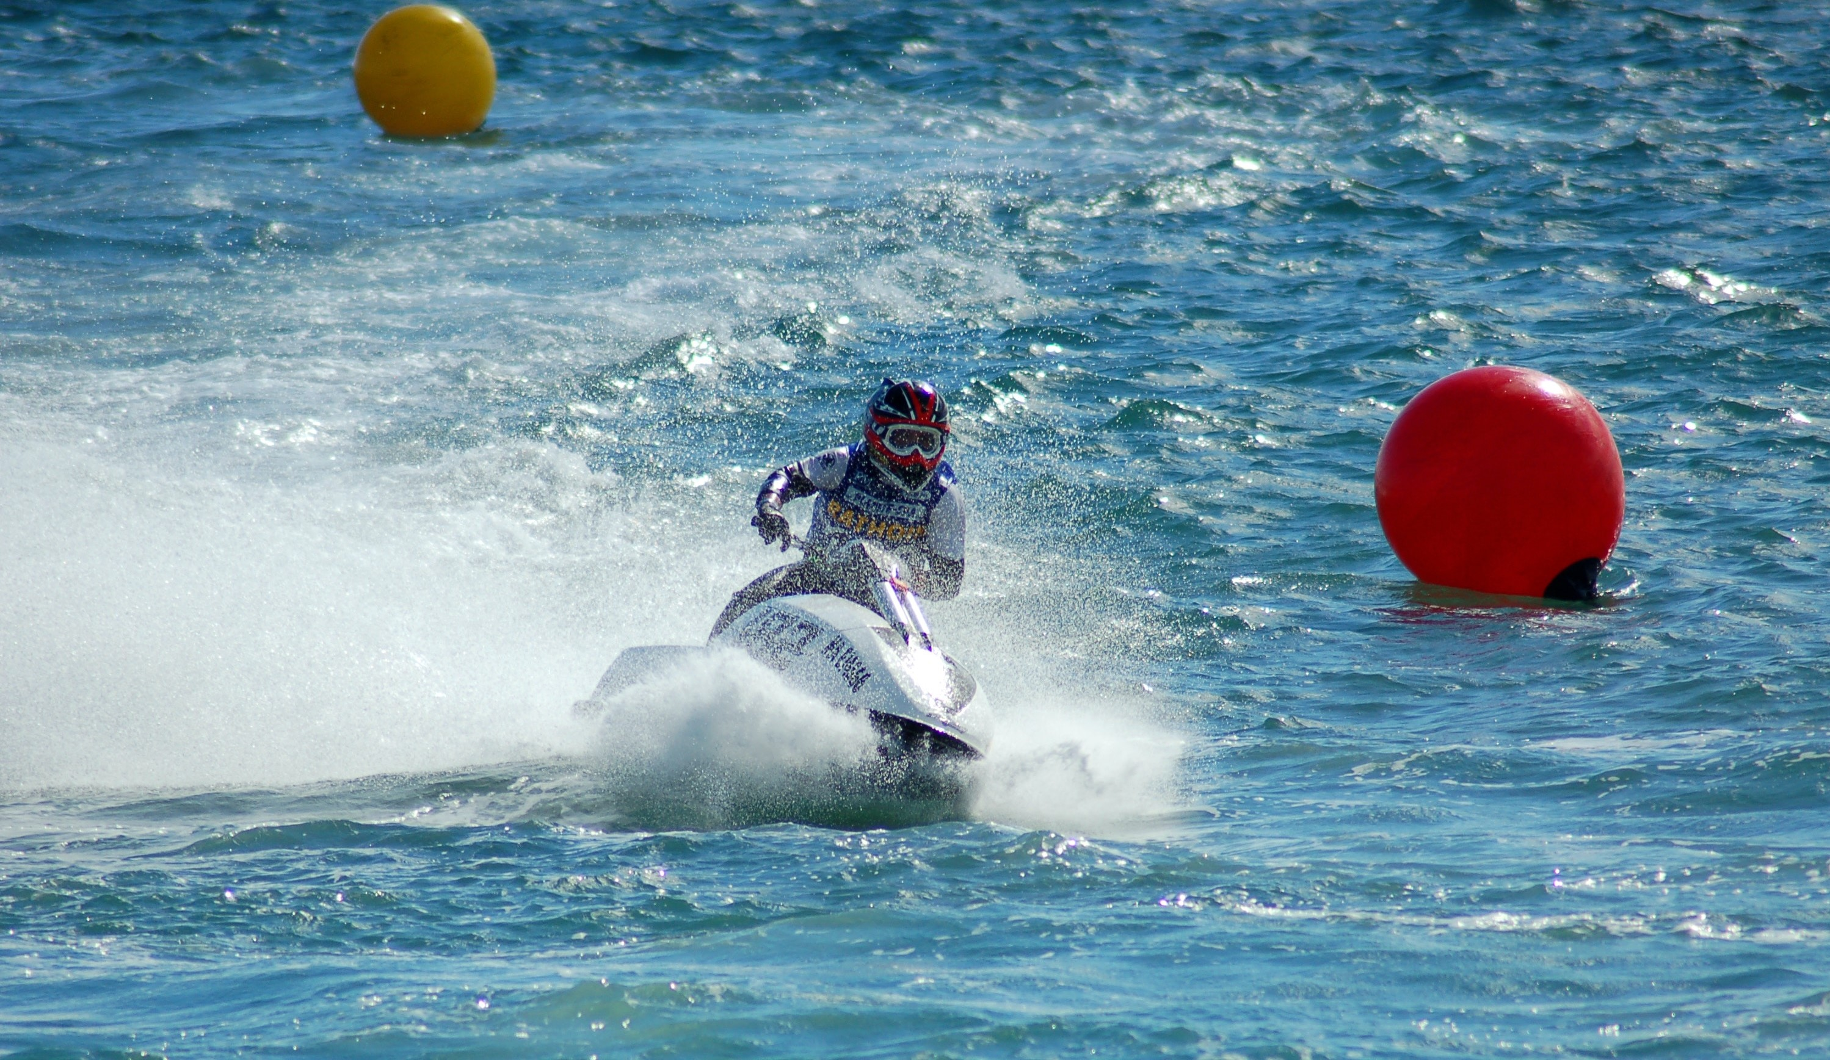
Maneuvering and PWC Handling
Notes:
There are two general rules when operating a PWC:
Maintain a lookout at all times
Always proceed at a safe speed
PWC operators must respect the rights of others by exercising basic courtesy and common sense. This way, accidents can be prevented, and negative opinions toward personal watercraft can be avoided.
PWC operators must constantly keep a sharp lookout for other vessels, swimmers, and other objects at all times. Operators must avoid “tunnel vision” by constantly looking all around to avoid potentially hazardous situations.
PWC operators are responsible for any damage to other boats and shoreline property caused by its wake. When operating the PWC near swimming areas, beaches, marinas, docking areas, and waterfront residences, pay particular attention to your speed. Many areas are marked with posted speed limits and NO WAKE signs or buoys.
PWCs are generally high-performance vessels. Given that they have different handling characteristics than traditional boats, inexperienced operators can easily injure themselves or others without the proper handling experience. Operators should gain experience at slow speeds and controlled conditions before attempting advanced maneuvers or engaging in towed watersports. Operating a PWC beyond one's skill or ability may result in property damage, injury, or death.

Slide 28
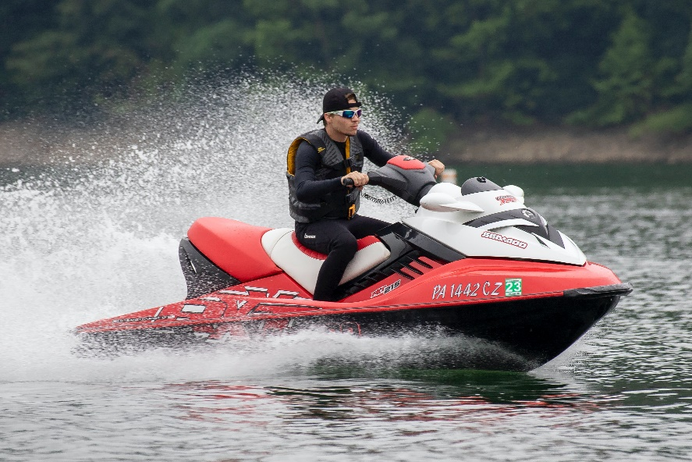
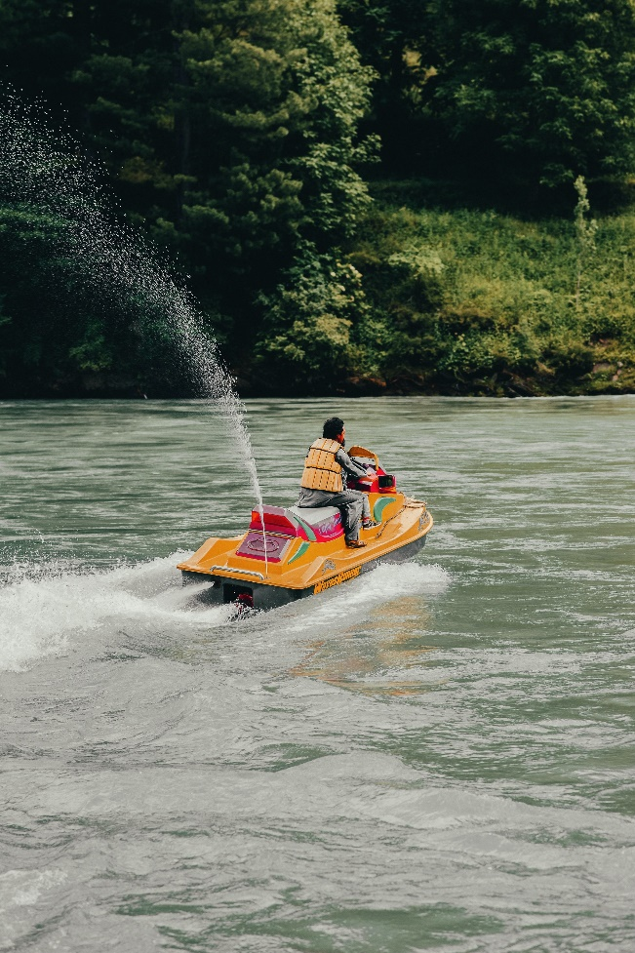
Safe Handling
Avoid docks, piers, rafts, obstructions, other vessels, and swim areas
Don’t go out alone
Learn and follow the Rules of the Road
No power = no steering control
Never operate your PWC at night
Know your limitations and those of your PWC
Notes:
It really is best if you make a habit of driving the PWC at cruising speeds in normal traffic lanes, in open waters, and, at slower speeds, in the vicinity of your own dock or mooring. That means avoiding other docks, piers, moored or anchored boats, swim areas, boat access ramps, areas with diver-down flags, and any obstruction.
When you are cruising in open waters, go in an intended direction at a controlled speed and make course changes very obvious so that other boaters know exactly what you are doing. This gives them the opportunity to react appropriately.
The video you saw earlier emphasizes the need to have positive throttle to have steerage. We have talked about it quite a bit, and here it is again. We suggest that when you are training and practicing on your PWC, you go to an open area with no obstructions and practice turning with and without much jet thrust, stopping with and without any installed reverse thrust feature, and, especially, practice turning quickly with some throttle so you know how much throttle it takes to have control and how to lean to maintain balance. Don’t be afraid to practice, at idle, falling off your PWC and remounting.
Finally, the “tough one”; try a rapid stop while attempting a sharp turn. One takes low throttle settings, and the other demands some throttle. You will prove to yourself that you don’t want to get into a “high angle approach” situation where you need to make a sharp turn and rapid stop at the same time.
Double check with your state if it will allow you to operate your PWC at night if you equip it with proper running lights.

Slide 29
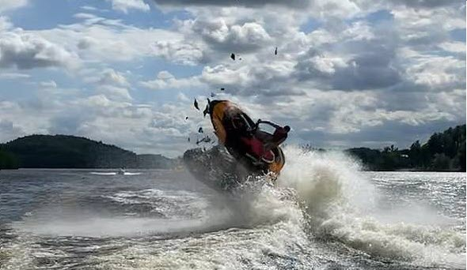
Avoiding a Mishap
Look over both shoulders before making turns
Mishaps are usually “human error”
Be courteous and respectful of others
Watch the weather
Notes:
Remember, the primary cause of mishaps is failure to keep a sharp lookout. Being unaware of what is around you is especially hazardous when you are moving through the water at speed. A collision can be catastrophic. The photo in the slide is just such a collision.
Generally, you cannot rely on your mirrors. The image is too small; often, objects are closer than they appear, and while you are searching for something in the mirrors, you are unable to directly watch for hazards ahead of you.
Break the “unsafe chain of events,” and you may avoid suffering the accident.
Avoid high-speed passes directly at people, boats, and other obstructions. That is to say that the best approach to an area where obstructions (docks, piers, other boats, swimmers, anglers, etc.) is “not” directly at it but, instead, a “low angle” more nearly parallel approach.
Slow is Pro. You “ease up next to the obstruction” rather than driving right toward it. If you avoid actually “touching it,” you did it right.
On small vessels like PWCs, changes in the weather can be disastrous. If you see dark clouds, shifting winds, and graying skies, you need to head for a safe place. Water conditions can become dangerous before you know it. If caught in stormy weather, PWC operators should avoid taking waves on the vessel’s beam and should take waves at a 90⁰- angle (directly at the bow) to avoid capsizing.
Don’t jump wakes.

Slide 30
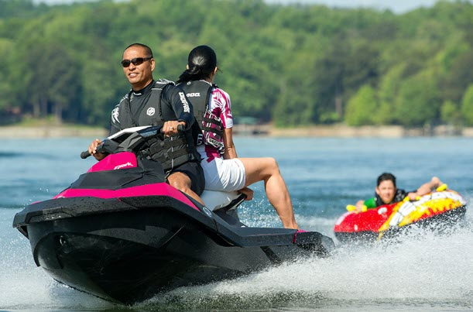
Towing
Best Practice: Use an observer
Watch the “swing distance” of the tow rope
Turn off the engine before the water-skier or tuber climbs back on board
Notes:
Some states permit a wide-angle mirror vs. another passenger as the tow monitor. However, although legal, we have found it is not very helpful to use a wide-angle mirror because the PWC driver has limited visibility in the mirror and is distracted from observing and avoiding other obstacles due to the distraction. We have seen instances when a person riding a towed inflatable fell off and was not immediately recognized as no longer on the float, adrift for a while.
When pulling a water-skier or tuber with a PWC, you should have an observer who faces astern. This observer keeps an eye on the water-skier or tuber and keeps the PWC operator informed of their status.
Other riders on a PWC must always wear a life jacket. Additionally, since a water-skier or tuber is also considered a boater, the PWC should have the seating capacity of three people (operator, observer, and water-skier or tuber).
Personal watercraft will likely operate differently while pulling a water-skier or tuber. You should allow for more time to maneuver your craft. Since seeing a skier in the water may be difficult, always return to a fallen water-skier as soon as possible.
Be aware of the “swing distance” of your tow rope. Avoid swinging the towed skier or inflatable device into obstacles, particularly in high-speed turns.
Be careful not to ingest the tow rope in the intake. However, bring a knife in case this happens.

Slide 31
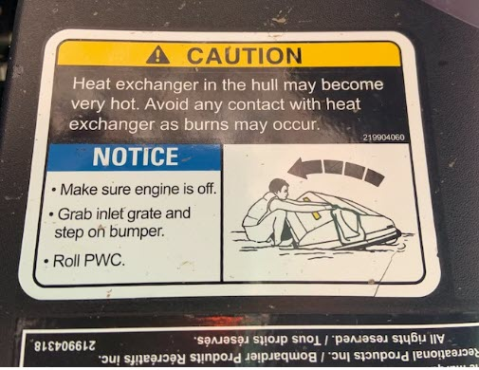
Capsized PWC
Know how to right the PWC correctly
Decal on the stern shows the direction of rotation
Under normal operation When capsized
Notes:
As you can see on the slide, when the PWC is operating in its normal mode, the decal on the stern is upside down. If the PWC capsizes, the decal is readable.
If the PWC rolls over, look for the manufacturer’s label that shows the proper direction to turn it back over to avoid serious engine damage. Failure to right the PWC correctly may cause water to enter the intake and cause the PWC to fail to restart, possibly damaging the engine. When the watercraft is capsized, do not attempt to restart the engine.
You should be fully capable of re-boarding the PWC from the water since this can be difficult when you are tired and inexperienced.
Capsizing is common for PWCs, and this hazard can be mitigated by following some safety practices. A PWC’s stern wake can swamp the foot well, adding extra weight to the PWC, making it unstable and prone to capsizing. To avoid this, make gradual slow-downs instead of abrupt slow-downs. In addition, waves and wind can cause a PWC also to become unstable. Plan to encounter waves at a 90⁰ angle to mitigate making the vessel unstable. Abrupt turns can cause the vessel to become unstable, making it difficult for passengers to hold on. Avoid sharp turns and communicate with passengers about changes in direction.

Slide 32
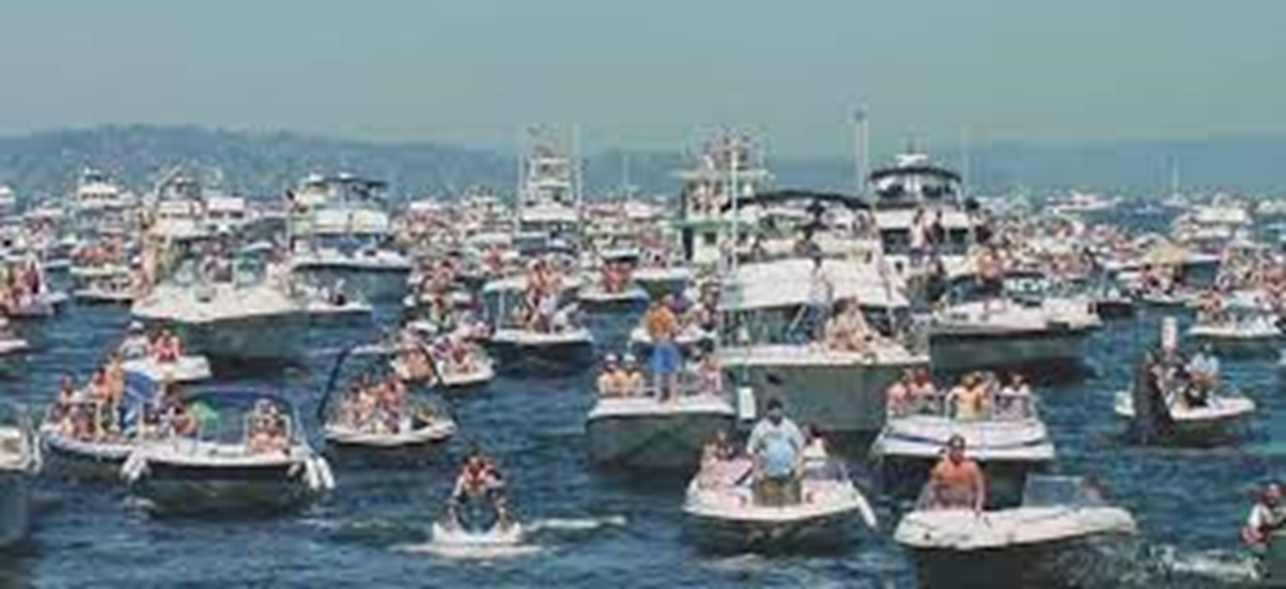
Rules of the Road
Defining Who Has the Right of Way
Notes:
The Rules of the Road help tell you what you need to do to keep safe and avoid collisions.

Slide 33
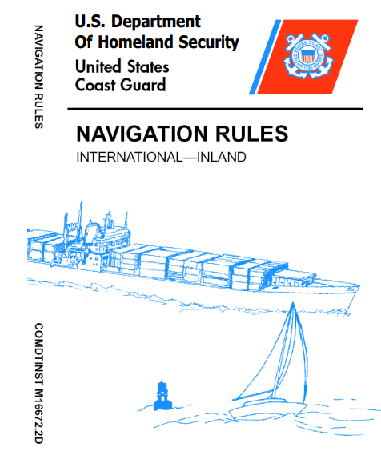
Rules of the Road
Defining Who Has the Right of Way
In the absence of roadways, “yield” or “stop” signs, and other “highway markings” on the water, you need to know some Rules of the Road.
Notes:
There is a lot of information in the Navigation Rules – much of it applies to vessels larger than PWCs. However, there are certain terms and concepts that a PWC operator must know to keep themselves, their passengers, and other boaters safe on the water. The other name for the Navigation Rules is the Colregs – regulations to avoid collisions at sea.
The two most important concepts to remember deal with activity and maneuverability. Activity refers to whether you are being overtaken (passed) by another vessel; whether you are overtaking another vessel; if you’re crossing the path of another vessel; or if you’re meeting a vessel head-on.
Maneuverability refers to how easily your vessel can move out of the way to avoid a collision and how it compares to the other vessel.

Slide 34
Rules of the Road
Terms of Reference
Stand-On
Give-Way
Crossing
Meeting Head-on
Overtaking
Hierarchy of Maneuverability
Notes:
There are a few “terms” you should learn.
The “Stand-On” vessel has one specific duty – it should maintain course and speed
The “Give-Way” vessel must alter course or speed as necessary to avoid a Stand-On vessel.
A vessel is considered crossing if it comes from the port (left) or starboard (right) side of your PWC – a little more on that in a minute.
A boat is considered meeting when the other vessel is coming at your PWC head to head
Overtaking means the other vessel is passing your PWC or you are passing the other vessel
The hierarchy of maneuverability essentially says that whichever vessel can more easily get out of the way of another vessel must do so. As you can imagine, your PWC is highly maneuverable and needs to stay out of the way of most other vessels. Especially think about your PWC’s ability to maneuver compared to a sailboat, canoe, or kayak.
Always be prepared to give way to boats that do not know or are not following the rules of the road.

Slide 35
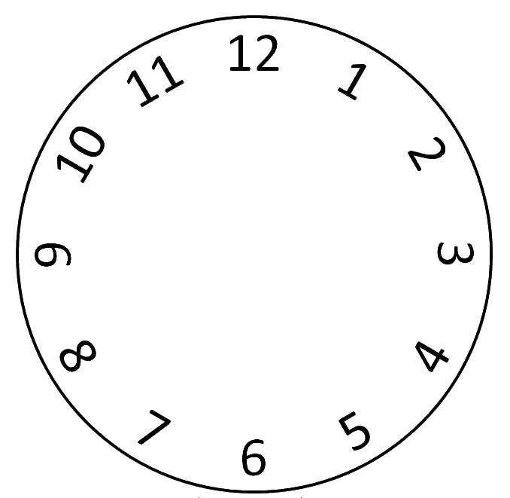
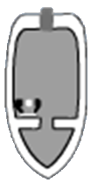
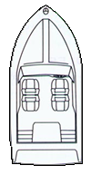
Rules of the Road
Terms of Reference
Meeting
Meeting
Crossing
Crossing
Crossing
Crossing
Overtaking
Overtaking
Notes:
To easily understand how to apply the terms, let’s look at the information on the slide. But, first three hard and fast rules:
The more maneuverable vessel is ALWAYS the give-way vessel, EXCEPT for
The overtaken vessel is ALWAYS the stand-on vessel
When two power vessels are meeting head-on, both are stand-on vessels.
So, back to the slide:
You are in the circle’s center, and your bow is pointed to 12 noon.
For any vessel that approaches you from one o’clock to four o’clock, you are the give-way vessel – you must maneuver to keep out of their way – preferably behind them
For any vessel that approaches you from five to seven, you are the stand-on vessel –you must maintain course and speed – remember rule two.
For any power vessel that approaches you from 11 o’clock to eight o’clock, you are the stand-on vessel – you must maintain course and speed. Note, this is for power vessels only approaching on your port side, rule number one would prevail for a sailboat or canoe.
For any power vessel that approaches you from 11 o’clock to one o’clock, you both are the give-way vessel – you must maintain course and speed. Note, this is for power vessels meeting head-on, rule number one would prevail for a sailboat or canoe.
Also, if the give-way vessel doesn’t give way, even though you are the stand-on vessel, you must give way and take any necessary action to avoid the collision.

Slide 36
Rules of the Road - Review
When your PWC meets another power vessel head-on (12 o’clock), which is the give-way vessel, and what actions should be taken?
When your PWC meets a sailboat head-on (12 o’clock), which is the give-way vessel, and what actions should be taken?
A powerboat is approaching your PWC from about 2 o’clock. Are you stand-on or give-way? What actions should you take?
Notes:
When two power vessels meet head to head, both vessels are give-way, and the usual course of action is to pass port to port (in other words, turn to your own starboard).
This is where the rule of maneuverability comes in. The PWC is the give-way vessel and should steer to starboard. The sailboat is expected to maintain course and speed.
Your PWC is always the give-way vessel for any boat approaching you from one o’clock to four o’clock. You should arrange to pass behind the vessel, which may require a turn to starboard. If that’s not possible, stopping and waiting for the powerboat to pass in front of your PWC is a good option.

Slide 37
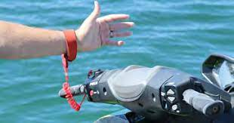
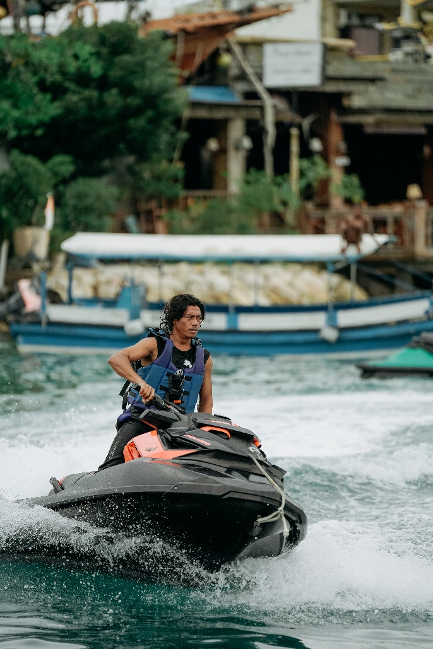
Federal Regulations and Laws
Equipment
There is certain equipment that you are required to wear on a PWC
Lifejackets and engine
cut-off switch lanyards (ECOS)
Notes:
When you break a rule, you not only put the safety of yourself and others at risk, it’s an offense, and you can get a fine. Laws change, so always check your local and state regulations.
Always wear a lifejacket – it can only save your life if you wear it. NOTE: Most states require that a PWC operator wear a non-inflatable life jacket (officially called a Personal Flotation Device or PFD). Lifejackets are the most important piece of safety equipment on any recreational vessel. When on board a PWC, it is essential that everyone wears an approved and appropriate life jacket. Lifejackets must be the correct size for the wearer and in good condition. As mentioned earlier, because of the speed that a PWC can attain, high-speed impact life jackets are recommended.
An Engine Cut-off Switch Lanyard (ECOS) connected to the PWC and the driver’s wrist or lifejacket must be worn at all times. If you fall off a PWC, the ECOS lanyard disconnects and stops the engine. With the engine shut down, the PWC will stop – preventing a dangerous situation where it could have circled around at high speed and hurt the operator in the water, boaters, or property in the area.

Slide 38
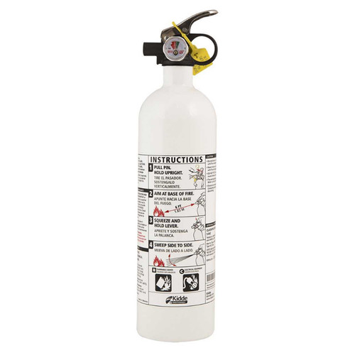
Federal Regulations and Laws
Equipment
There is certain equipment that you are required to have with you on a PWC
Fire Extinguisher
Notes:
It seems like having a personal watercraft fire extinguisher should be enough. However, you need also to understand it. If you have never used a fire extinguisher before, and many people haven’t, do you know what to do? Do you aim the nozzle at the base of the flame or the fire itself? Should you fire it in one long stream or in short bursts? Do you need to move it back and forth or keep it still?
The best thing you can do is familiarize yourself with the instructions. There is a clear instruction label on the side of your extinguisher. Some have a metal pull pin or other security features. These are to prevent accidental discharge. You’ll need to know how to disengage those. Check pressure status as well. All the steps required will be listed. If it’s too old, replace it. What is too old? Fire extinguishers have a 12-year life based on the date of manufacture. The date is normally stamped on the bottom of the fire extinguisher.
Usually, a fire on a PWC should be attacked from the base. Release the metal pull pin. Press the button or pull the trigger with the nozzle pointed at the source of the flames. Move the extinguisher back and forth to cover the area evenly. Do this until the flames are fully extinguished. Always defer to the instructions on your particular extinguisher, however.
What if you can’t reach the fire extinguisher? This is a problem with some PWC fires. You may actually be sitting over where the fire starts. If that’s the case, you have some options.
A fire needs heat, fuel, and oxygen. Deprive it of any of those, and the fire dies. If you can’t get to the fire or the fire extinguisher, flipping the PWC may work. If you submerge the engine compartment, you will at least cut off oxygen. Be cautious, however. Fuel and oil can leak into the water around you. Since they are lighter than water, the fire could continue to burn on the water’s surface.
If things are out of hand, save yourself before the PWC. Swim away and seek help rather than risk your personal safety.

Slide 39
Regulations and Laws
State Specific
There are certain regulations and laws that are specific to your state
Age restrictions
Boater or PWC class and/or license
Operating hours
Restricted areas
Towing requirements
Observer?
Wide-angle mirror?
Three seats required?
Notes:
As a PWC operator and/or owner, you need to be aware of your local and state laws relative to:
Age restrictions. How old do you have to be to legally operate a PWC? How old do you have to be to rent a PWC legally?
Safe boating or PWC classes. Does your state or locality require the PWC operator to pass a class? Are there specific classes for PWC operators? Are there certain age requirements for PWC classes? Does your state issue specific licenses for PWC operators? If so, how do you acquire that?
Since PWCs are not equipped with navigation lights, what are the operating hours in your state? Sunset to sunrise? One-half-hour before sunrise to one-half-hour after sunset?
Are there areas where you operate your PWC that restrict entry? Often states, counties, or municipalities will have local laws restricting the operation of powerboats or PWC. These are sometimes imposed for noise limitation or environmental concerns.
If you are going to use your PWC to tow water skiers or tubers and the like, make sure you are aware of the local laws. Some areas require an observer facing backward who must watch the skier or tuber. Other states may allow wide-angle mirrors. In some localities, the PWC must be large enough to hold three people – the operator, the observer, and the person being towed (to give them a ride to and from the dock).

Slide 40
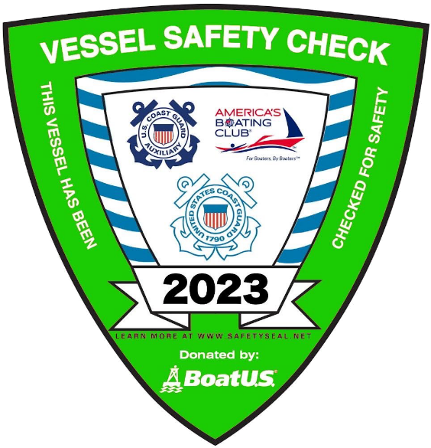
Regulations and Laws
Vessel Safety Check
Certified CG Auxiliary Examiner will:
Check your PWC for safety equipment and compliance with federal, state, and local laws
Answer questions
A Vessel Safety Check may help you receive a discount on your PWC insurance
Schedule a Vessel Safety Check at
https://wow.uscgaux.info/i_want_a_vsc/index.php
Notes:
The Vessel Safety Check program is a cornerstone of the Coast Guard Auxiliary's recreational boating safety mission. A Vessel Safety Check (VSC) is a free lookover of your PWC and its equipment for compliance with federal and state safety requirements. If your vessel meets all the VSC requirements, it is awarded a VSC decal.
The Vessel Examiners performing your VSC have been trained to look for the more common problems which might occur in your PWC or with its safety equipment. Some items your examiner will check include: vessel registration, life jackets, distress signals, fire extinguishers, and sound-producing devices. The Vessel Examiner will award the VSC decal if your vessel passes all parts of the check.
Also, during your VSC, the Vessel Examiner will talk with you about the purpose of specific marine safety equipment, discuss certain safety practices, and answer any related questions you have. Some topics discussed include survival tips, fuel management, interpreting sea conditions, and how to report accidents. Your examiner is also available to clarify various federal and state regulations for boating in your area.
Your decal may offer third-party benefits – talk to your insurance provider to learn more.
You can schedule a VSC at your convenience by going online to: https://wow.uscgaux.info/i_want_a_vsc/index.php

Slide 41
Aids to Navigation
Providing a Safe Depth to Operate and Vital Information
Notes:
Navigational markers, much like street signs, issue warnings, and instructions. PWC operators must learn how to read these markers to navigate waterways.
Navigational markers, abbreviated as ATON, may be lighthouses and beacons. However, the most familiar navigational markers are buoys and channel markers. There are a variety of buoys and channel markers, each with unique characteristics. These characteristics ensure that it isn’t mistaken for another signal. Additionally, a buoy’s or channel marker’s characteristics include lighting, color, shape, numbering, or lettering.
Buoys and channel markers line either side of the channel. This is called the lateral system. While returning from the sea to the harbor, entering a smaller body of water, or going upstream to the headwaters, the rule of thumb is red on the right. Often, mariners remember this by the saying, “red right returning.”
Mariners also rely on buoy and channel marker numbering. Numbers increase along the way to a smaller body of water. Moreover, green buoys always possess odd numbers, and red ones have even numbers.
ATONs help the boater avoid hazards like rocks and shallow waterways.

Slide 42
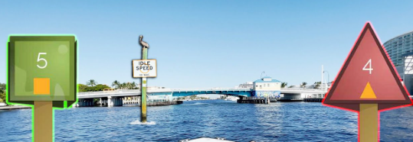
Aids to Navigation
Lateral Aids
Define safe waterways
Lead you in and out of your boating area
Help with trip planning
Notes:
Red and Green markers are among the most easily recognizable water markers. Knowing what the red and green markers indicate is a big step in navigating your way through the open waters.
Lateral markers are a type of water marker that marks the boundaries of the water to indicate a channel or waterway. They show the section of water that is established for the passage of vessels and is thus considered safe water.
Aside from establishing waterways, they are also used to aid in navigating and directing traffic on the water. Red and green mean specific things, along with other indicators on these markers, such as numbers and sometimes even shapes.
Lateral markers (ATONs) are an essential part of boating and should not be taken for granted.
The yellow triangles and squares on the slide denote the Intracoastal Waterway, called the ICW. The ICW runs along the eastern coast of the US from New Jersey around Florida and all the way to Texas. As a rule of thumb on the ICW, keep the red markers with the yellow triangles on the land side and the green markers with the yellow squares on the “open” water side (the Atlantic Ocean or Gulf of Mexico).
The well-prepared PWC operator should consider purchasing a nautical chart of their boating area. This chart will show the channel markers, their characteristics (like the number, color, lights, etc.), and potential navigation hazards.

Slide 43
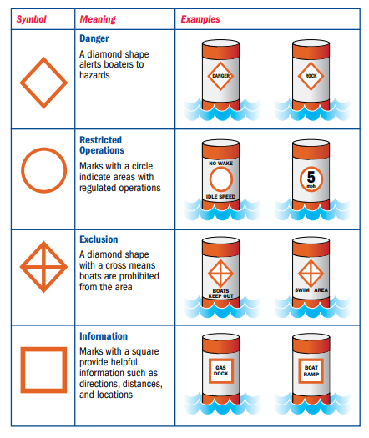
Aids to Navigation
Informational and Regulatory Markers
Provide Information
Warn of hazards and dangers
Include speed and exclusion areas
Notes:
Orange and white aids are used to indicate various regulations like speed zones and fisheries regulations. These will have an orange diamond shape on them if they mark a hazard, a circle if they indicate regulations related to how you operate your boat, a diamond with a cross through it if boats are prohibited from the area, or a square when they are used for informational purposes.
The PWC operator needs to be familiar with these markers since they will let you know where danger lurks (rocks, dams, rapids, etc.), where to get gas to fuel up your PWC, where you are excluded from (swim areas, specific harbors, etc.), speed zones (idle speed, no wake, minimum wake, etc.), and seasonal warnings (manatee, right whale, etc. zones).
Many tickets have been issued to PWC operators by law enforcement because they fail to see these warning markers or did not understand their meaning.

Slide 44
Aids to Navigation Review
What is meant by the term “red, right, returning?”
Lateral aids to navigation provide what important boating assistance to the PWC operator?
Regulatory buoys provide what important boating assistance to the PWC operator?
Notes:
A vessel returning from the sea and approaching an entry channel should expect the red even numbered nun buoy or red triangle daymark to be on the right side of the channel.
If you are in unknown waters and remain between the red and green buoys or day markers (in the defined channel), you are in defined good waters and should have adequate depth for vessels normally operating in these waters.
Regulatory markers alert the mariner to various regulatory matters such as horsepower, speed, wake, or entry restrictions. Danger markers provide the mariners with information concerning dangers or obstructions to navigation, such as shoals, shallows, rocks, submerged piper or cables, dams, or low clearance obstructions above the water, like power lines, trestles, or bridges. Information markers provide the mariner with information concerning matters other than danger or obstructions to navigation or regulatory matters.

Slide 45
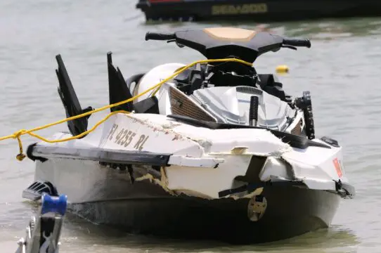
Safety and Risk Management
Identify Hazards and Develop a Plan
Staying Safe on the Water
Notes:
The Coast Guard and Coast Guard Auxiliary are committed to reducing fatalities and serious injuries on US waterways. Certain behaviors and factors are commonly linked to incidents on the
water. Avoiding these behaviors and making better decisions will reduce your risk.
There are many different leading causes of PWC accidents. PWC accidents can often be caused by operator error, careless operation, excessive speed, or alcohol use. However, there are also many other leading causes of PWC accidents, including mechanical problems, bad weather, and waves or wakes from other boats.
Operator error is one of the leading causes of PWC accidents. Often, operators will not have enough experience with the personal watercraft to know how to operate it properly. They may also be careless when operating the PWC and not pay attention to their surroundings. Additionally, operators may try to go too fast or show off to other people, which can lead to accidents.
Mechanical problems can also be a cause of PWC accidents. If the PWC is not properly maintained, it can break down or malfunction while in use. This can be very dangerous.
Waves or wakes from other boats can also cause PWC accidents. If the operator is not paying attention, they may not see a wave or wake coming and be knocked off the personal watercraft. This can be especially dangerous if there are other boats in the area. Sometimes, you can also be run over by your own PWC if you drive recklessly.

Slide 46
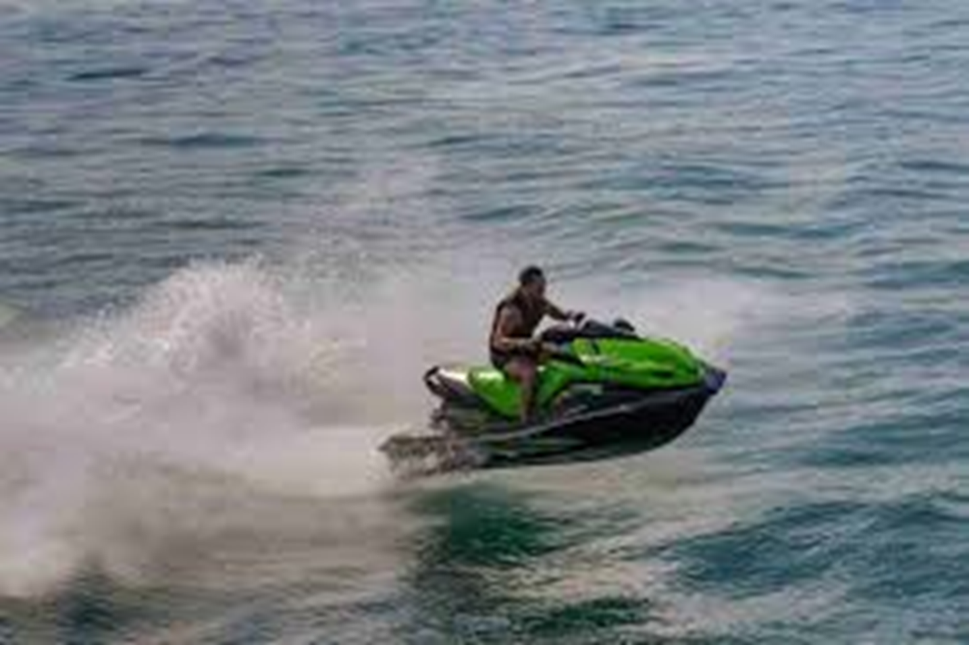
Safety and Risk Management
Wake Jumping
Notes:
Jumping waves is fun for most PWC operators. However, most states have laws prohibiting the jumping of a wave directly behind another boat. These laws were written, passed, and enforced because too many accidents have been caused by boats (not just PWCs) riding directly behind another boat then pulling out and passing the boat by jumping its wake. When law enforcement officers see this, a ticket is usually written. The ticket is written for “reckless operation of your vessel” and not “wave or wake jumping.” Because your vessel becomes “airborne” and leaves the water you lose all capability to control your vessel and you most likely will not be able to see a wide area directly in front of your vessel. This is clearly reckless operation of your vessel.
If you must “jump waves” why not do it in a secluded area away from other boats? Most newer PWCs have powerful motors and gross weight over 700 pounds. This makes these machines capable of generating sizeable wakes. By turning tight circles in rapid succession, waves up to 3’ can be obtained. While the Coast Guard never recommends the reckless operation of a vessel, there are safe ways to enjoy your watercraft away from navigation hazards and other boaters.
Remember: you are responsible for your wake and any damage your wake may cause to another vessel. While you may have generated a wave in a secluded area, the wave can travel over a mile and still have enough dynamic energy to cause damage to another vessel or dock.

Slide 47
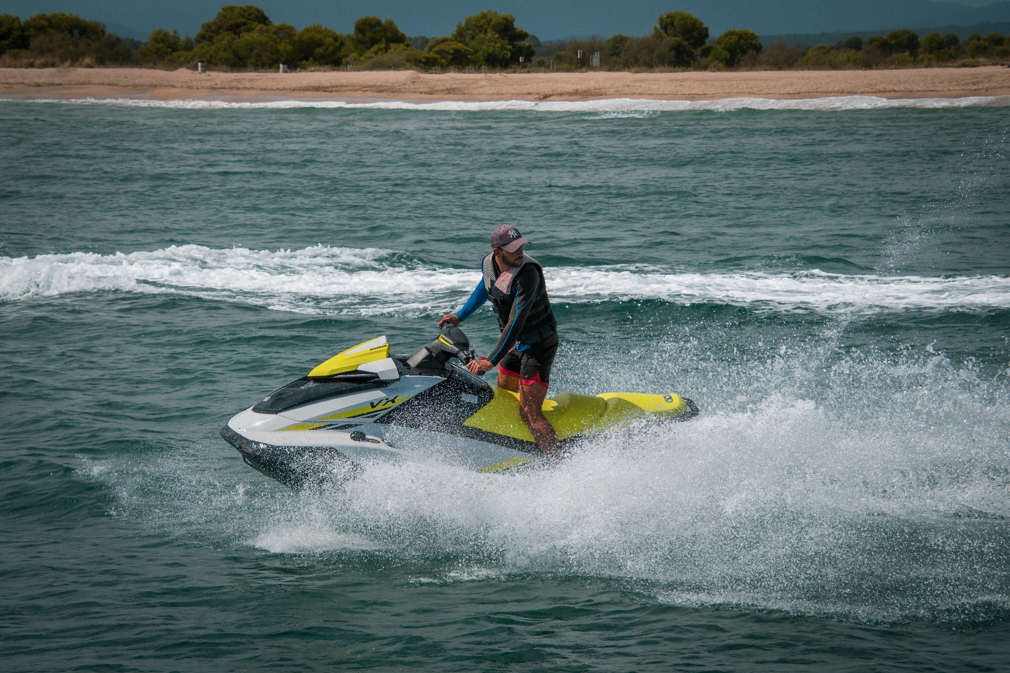
Risk Management
Identify Hazards and Develop a Plan
Situational Awareness: Always be aware of where you are, where other boats are, and where they are going
Notes:
Situational Awareness gives you the tools to avoid accidents. This means being aware of our surroundings and identifying potential threats and dangerous situations. This is more of a mindset than a skill. Ignorance of potential danger makes it unlikely that you will see the threat. You must recognize that dangerous situations exist, even in the most routine places. This is especially true on the water.
When you’re cruising on your PWC, lots of things are happening all at the same time: the PWC is fast, low profile, other boaters are using the same areas you are, the weather may be a factor (hot or cold), sometimes you’re give-way, sometimes you’re stand-on, etc. With this much demand on you, your decision-making ability can be compromised, and your awareness of what’s happening around you (even the obvious) can be missed.
PWCs have a low profile, making them harder to see than other power watercraft. Many other boaters haven’t had any boater education and don’t know or understand the rules of the road. That means your safety is up to you.

Slide 48
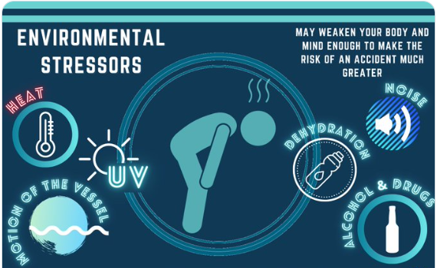
Risk Management
Increased Risk From Stressors
Sun’s glare
Heat
Motion
Noise
Vibration
Other vessels
Notes:
Knowing the stressors involved with boating can help keep you safe on the water. Many people mistakenly think that boating is no different than driving. Unfortunately, they quickly find out that it is much different indeed. While driving great distances can encourage fatigue, there are more stressors on a boat than in a car, such as:
Sun Glare - The sun bouncing off of the water and into your eyes is tiring. Think of driving into the sun for hours on end with no visor to help you. Anyone driving a PWC is encouraged to wear a pair of sunglasses that blocks the sun’s rays from the front and the sides to help reduce glare and fatigue.
Motion - You have seen mothers rocking babies to put them to sleep. Imagine what driving a PWC all afternoon can do to you. The persistent rocking can cause you to become drowsy quickly. For some people, this rocking can cause motion sickness, a problem in and of itself.
Vibration - Feeling a constant vibration under your feet and beneath your hands can tire you. It is suggested that you take frequent breaks. Turn the controls over to someone else from time to time if it is safe to do so, or go to shore and get off the PWC for a while.
Noise - Many people use white noise to fall asleep at night. Falling asleep is not what you want to do when you are piloting a PWC, but the consistent humming of the engine can make your eyes heavy. If the noise gets to you, pop in your earbuds and listen to some of your favorite tunes to break up the monotony.
Boating stressors like these put you at an increased risk of an accident. They are natural and cannot be avoided but can be lessened with a proper plan. Fatigue is a danger to anyone operating a PWC and all those on board.

Slide 49
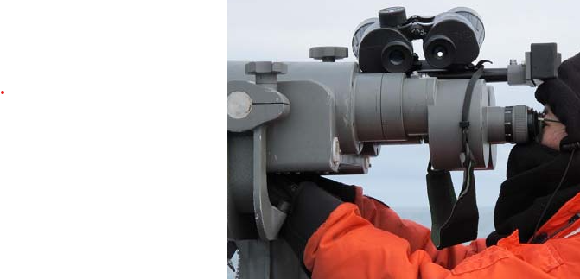
Risk Management
Minimize Risk
Everyone on board must wear a life jacket
Follow the Rules of the Road
Keep a sharp lookout
Look in all directions before turning
Never operate a PWC when fatigued
Drive defensively
Notes:
Activities like wakeboarding, water skiing, being towed on an inflatable tube, and riding a personal watercraft present a risk of repeated water entry at high speed. Your PFD must remain intact and securely attached to your body. Belted vests with three or four strong belts encircling your torso work best because they won’t get torn off easily, even when you wipe out at high speed.
Remember to give way when another vessel is in the one o’clock to four o’clock position relative to your PWC. And, be prepared to give way even when you’re the stand-on vessel if the other vessel isn’t obeying the rules of the road.
Pay attention to everything going on around you and maintain a safe speed so you can avoid a collision with another vessel or a fixed object. Stay within the channel markers to avoid running aground or getting into water that is too shallow.
Use your mirrors and turn your head to look over your shoulder before making a turn to port or starboard. Similarly, carefully look behind you for following boat traffic if you plan to slow down or change course.
Be careful of fatigue since it’s easy to make bad judgment calls when you’re tired.
Drive your PWC defensively – assess all situations for the potential of risk and make the right decision to avoid a collision.
Wear protective gear like goggles or sunglasses, gloves, foot protection, sunscreen, and proper clothing for the water temperature. Remember to bring drinking water to stay hydrated.

Slide 50
Safety
Alcohol and Water Don’t Mix
Notes:
Almost half of all boating accidents involve alcohol. That should be reason enough to leave alcohol consumption for when you are safely ashore with no plans to travel. Operating a PWC while intoxicated is a federal offense, subject to a fine. In addition, criminal penalties may even include jail time. State Boating Under the Influence (BUI) Laws are becoming more stringent too. In most states, the standards for determining whether an individual is intoxicated match its state highway laws for operating a vehicle.
In most states, it is illegal to operate a boat with a blood alcohol content of .08% or greater. Some states will suspend your boating license or privilege. In some states, your driving record could be affected. Your boat could be seized or sold at auction.
Alcohol reduces inhibitions, causing normally cautious people to try stunts or enter high-risk situations a sober person would avoid. Alcohol severely diminishes your ability to react to several different signals at once. It takes longer to receive information from your eyes, ears, and other senses and even more time to react.
Stressors, such as exposure to noise, vibration, sun, glare, wind, and the motion of the water, affect PWC operators and passengers, thus making drinking while boating even more dangerous than drinking and driving. Research shows that hours of exposure to boating stressors produce a kind of fatigue, or "boater's hypnosis," which slows reaction time almost as much as if you were legally drunk. Adding alcohol or drugs to boating stress factors intensifies their effects - each drink multiplies your accident risk.

Slide 51
Safety
Common Issues
Reckless or careless operating
Falling off
Notes:
It has been said that a wise man learns from others’ mistakes. Here are some very common issues on the water that you can learn from.
Reckless operation is a violation of the law, and you can be cited. It means boating in a way that could endanger someone’s life, safety, or property. Avoid operating in swimming areas or other restricted water. Don’t weave through congested traffic. Swerving at the last moment to avoid collision is actually talking about high-speed runs at other vessels or obstacles and a last-minute swerve to impress them or to splash them with water. Of course, you should avoid doing that. On the other hand, swerving to avoid a collision while conducting normal cruising or taking other emergency evasive action is permitted under the Rules of the Road.
Although they’re commonly known as kill switches or kill cords, the correct name is engine cut-off (or cut-out) switch ECOS). It’s a safety device that immediately shuts off the engine if the PWC operator becomes separated from the PWC’s controls. The ECOS is a simple ON/OFF switch that completes an electrical circuit to the motor when it’s on, allowing it to run. When the switch is off, it breaks the electrical circuit to the motor, preventing the engine from running.
The ECOS is attached to the operator. If the operator is thrown overboard, the connection between the operator and the ECOS is severed, and the switch automatically turns the engine off, immobilizing the PWC from continuing on unmanned.
Passengers should hold on tight since falling off at high speed can mean significant injury. If a passenger falls overboard, the PWC operator should immediately return to the passenger and shut off the motor before having the passenger climb back aboard to avoid injury.

Slide 52
Safety
Common Issues
Towing skiers or tubes that collide with objects or too close to shore, docks, piers, and swimmers
Wake jumping
Riding too closely behind another PWC or boat
Notes:
Proximity has hazards related to reflexes and water conditions. Stand off to a safe distance. Your PWC does not have true brakes. It may have a “reverse thruster” feature but does not “stop” as it would with brakes. Do not ride directly behind another boat.
Operating close to a dock, moored vessel, pier, swim float, marked swimming area, swimmers, surfers, persons engaged in angling, or any manually operated propelled vessel can have disastrous consequences.
Avoid high-speed passes close to obstructions. Riding your PWC like a “Dirt Bike” is generally disastrous. Dirt bikes have brakes; you do not. Dirt bikes have wheels on somewhat solid land; you do not. Avoid setting yourself up for an accident. High-speed passes, close to obstructions, are fraught with danger. Direct approaches at high speed are also dangerous. Jumping wakes “in close” to the wake-producing vessel has caused accidents and deaths.
Remember, if you see a “collision” coming, your natural reaction to reduce throttle to idle will cause you to lose directional control. Remember that if you make a sharp turn to avoid an obstacle, your tow may be accelerated into the obstacle with sometimes disastrous results.
Unfortunately, most of what you see done close to shore and in tight spaces (radical maneuvers, rapid acceleration, tight turns, “dirt bike type riding”) is, at least, “careless.” Pick an open area, avoid other boaters, or, if they are there, wait until they are not going to be endangered.
In most cases, wake jumping a boat producing the wake is illegal. PWCs ride low enough in the water that, often, any other boat or stationary obstruction on the other side of the boat wake being crossed is likely not visible until the PWC is immediately in its path. The wake jumper relies on the other boater maintaining course and speed. If, due to uncertainty, that boater abruptly turns, slows, or stops, a collision is more likely.

Slide 53
Safety
Common Issues
No wake zone violations
Over capacity
Harassing swimmers, other vessels, or wildlife
Notes:
Keep your speed at “no wake” when in designated no-wake zones or near a moored boat, dock, pier, or marked swim area. No wake requires you to operate your PWC at idle speed or as slow as possible while maintaining the ability to steer the PWC. Just because you are running your ski at the lowest forward RPM does not mean you are not putting up a wake. Most of the newer and heavier PWCs require the operator to shift between forward and neutral in order to produce “no wake.”
Having too many passengers on board can affect the stability and handling of the PWC. This should be pretty easy to avoid. Your passenger limit is the number of seats. Just don’t exceed them.
Some people on or in the water consider PWCs to be a nuisance based on the bad practices of some operators. Be a good boater and avoid engaging in activities that annoy or can endanger swimmers, other vessels, or wildlife.

Slide 54
Safety
Weather Emergencies
Slow down
Head to shore
Stow unnecessary gear
Make sure your passengers hold on tight
Notes:
Be alert to weather conditions. Watch for wind shifts, lightning, and rough water.
Bad weather can lead to PWC accidents. If the water is choppy or there is a strong wind, it can be difficult to control the personal watercraft. This can lead to accidents if the operator is not careful.
Slow down and make certain your passenger is secure. Stow unnecessary gear. If there is lightning, thunder, heavy rain, or wind, head for the nearest shore. Find a dock with adequate space for you. Tie up securely and get on shore. If it is a private dock, find the owner, introduce yourself, and explain your situation. Usually, a dock owner won’t refuse a boater in distress for a short while until a storm passes.

Slide 55
Safety
Summoning Help
Visual distress signals
VHF marine radio – Channel 16
Cell phone
Personal locator beacon (PLB)
Notes:
A Visual Distress Signal (VDS) is any device you can use to help others locate your PWC quickly in the case of an emergency. Visual distress signals include day signals that are visible in sunlight, night signals that are visible in the dark, and anytime signals that can be used both day and night.
The requirement to carry visual distress signals requires all vessels when used on coastal waters, which includes the Great Lakes, the territorial seas, and those waters directly connected to the Great Lakes and the territorial seas, up to a point where the waters are less than two miles wide, and vessels owned in the United States when operating on the high seas to be equipped with visual distress signals. The only exceptions are during daytime (sunrise to sunset) for:
Recreational boats less than 16 feet in length, boats participating in organized events such as races, regattas, or marine parades, open sailboats not equipped with propulsion machinery, and less than 26 feet in length, and manually propelled boats. But these boats only need to carry night signals when used on these waters at night (which PWCs may not do). Regardless, the well-prepared PWC operator will carry visual distress signals aboard to signal for help when needed.
A marine radio (mounted or portable) is an efficient method of summoning help. Tune your marine radio to Channel 16 to call for help. If you need it, remember the three “Ps.” That means make sure to transmit your position (a landmark, a channel marker, miles offshore, etc.), the problem (PWC taking on water, a fire onboard, medical emergency, etc.), and how many people are onboard. This gives the rescuers most of the information they need to initiate their action. A marine radio is much better for getting help than a cell phone.
Your personal locator beacon informs emergency rescue who you are, your location, and that you need immediate help—all via satellite messengers. Having a PLB with you could save your life.

Slide 56
Safety
Law Enforcement
Law Enforcement has the right to stop a vessel
You must stop and comply with their requests
Usually have blue lights
Notes:
If law enforcement signals you to stop, do so immediately, shut off your engine, and comply with their requests. They have the right to “board you.” Like you, law enforcement is promoting safe recreational boating on the waterways. Having that in common with you, they are a “friend” and are there to be of help.

Slide 57
Safety
Boating Accidents
If you are involved in a boating accident:
Stop immediately
Assist injured persons
Call for law enforcement help
File an accident report
Notes:
If you are involved in a boating accident, you must stop, render assistance, and provide your information. If you can safely do it, provide aid to injured persons on your PWC or the other vessel. At a minimum, call for help from law enforcement.
Call law enforcement on 911 or on VHF-FM Channel 16. Give your name, vessel identification, and exact location/landmark, if possible. Let them know where it occurred and who/what was involved.
If someone dies, disappears, suffers injury worse than what can be treated by first aid, or if there is damage to property in excess of $2,000, you must file an accident report as soon as possible.
Each state, and sometimes localities, has a different procedure for filing accident reports. The instructor should be aware of the proper procedure for their state and use that as information for the students in this class.

Slide 58
Safety
PWC Maintenance
Regularly service your PWC
Keep the hull free of damage
Check fluid levels regularly
Check for loose nuts, bolts, and screws
Notes:
It is important to ensure that your PWC is in good order by inspecting key features before you leave home or the ramp. The major causes of breakdown are engine failure, fuel shortage or contamination, mechanical failure, and battery failure. Always:
• Maintain your PWC to the manufacturer’s requirements and have the craft serviced regularly
• Keep the hull free of damage, algae, and other growth and the engine free of grease and oil build-up
• If the battery is not sealed, check battery fluid regularly and ensure that all of the electrical connections are clean and tight and all cables are lubricated and working smoothly
• Check for loose nuts, bolts, and screws.

Slide 59
Safety
Why So Many Rules and Regulations?
Prevent accidents
Manage risk
Safe enjoyment
Notes:
Pre-select where and around whom you have your adventure. Have fun without causing harm to others or the environment! Experience the thrills. Do so safely!

Slide 60
Risk Management and Safety Review
How is the “reckless operation” of your PWC defined?
What is the law if you are involved in an accident?
What are some of the stressors affecting you on the water?
Why should alcohol be avoided when you’re operating your PWC?
What is risk management?
Notes:
Reckless operation is operating in such a way that you could endanger another’s life, safety, or property.
If you’re involved in an accident, stop, render assistance, call law enforcement, and file an accident report if someone dies, disappears, requires help beyond first aid, or if property damage exceeds $2,000.
There are multiple stressors that can affect you on the water. Some of these are noise, heat, cold, motion, sun glare, etc.
Alcohol consumption can affect your judgment and reaction time on the water. Often, because of the stressors encountered while boating, the effects of alcohol are greatly magnified. Plus, boating while intoxicated or boating while under the influence is illegal and can subject you to jail and fines.
Risk management is recognizing dangerous situations and reducing the chance that they will happen. It also means lessening the effects of accidents if they do happen.

Slide 61
Summary
Always wear a lifejacket
Check the weather before you go
Always wear your engine cut-off switch (ECOS) lanyard
Keep a safe distance
Notes:
Always wear your life jacket – it can only save your life if you are wearing it. Remember, it should be impact rated.
Keep an eye on the weather when you’re out, and take extra care in cold water. If you see the weather deteriorating, head for shore and seek shelter.
Always wear the engine cut-off switch lanyard attached to the PWC and the driver. If you fall off a PWC, the switch lanyard will disconnect once you enter the water, causing the PWC’s engine to shut down and the machine to stop. Some older PWCs have an automatic idle and self-circling capacity. If you fall off, the PWC will circle slowly in the water until you can re‑board. In either case, swim to your PWC, re‑board carefully at the stern, re-attach the lanyard, and re‑start your engine.
If a passenger falls off a PWC, slow down immediately. Maneuver the PWC, taking care
not to hit the person in the water. Warn approaching vessels and approach the person in the water from downwind or against the current. When trying to pick the person up, turn off the engine. Remember, long hair can get sucked up into an impeller, just like a loose line can.
Travel at a safe speed which means you can safely avoid a collision.

Slide 62
Summary
Always travel at a safe speed and keep a lookout for others.
Know your limitations and those of your PWC.
Head out with others whenever possible.
Avoid alcohol and drugs when boating
Notes:
Keep a good lookout by sight and hearing. Be fully aware of the boating environment, especially in bad weather or restricted visibility. Look all around – even behind you. Don’t confuse the lookout duties of the driver with those of the observer when the PWC is towing a person. The driver is responsible at all times for keeping a lookout for danger.
A safe distance and speed between a vessel and a person or thing (including another vessel) is a distance and speed that will ensure that the vessel will not cause danger or injury to the person or damage to the thing, having regard to all relevant safety factors including adverse weather conditions, visibility, speed of the vessel and obstructions to navigation.
When driving a PWC (including when towing a person or people), you must keep the vessel, any towing equipment, and anyone being towed away from obstructions and dangers.
Driving under the influence of alcohol or drugs is an offense. The driver, the observer, and any person being towed must remain under a prescribed concentration of alcohol of .08. Even legally prescribed drugs can impair your operation of a PWC – beware of OTC drugs like antihistamines which can cause drowsiness. Taking painkillers while operating a PWC can also cause problems with attentiveness, fatigue, reaction time.
Make sure you know how to handle your PWC, especially in the waterway that you’re using. If in doubt, get information from locals. Make yourself a better and safer rider and familiarize yourself with how your PWC handles.

Slide 63
Summary
Obey the signs
Avoid traveling directly in the wake of another vessel
Always look behind you before you turn
Keep your PWC properly maintained
File a float plan
Summary Video
https://www.boat-ed.com/indiana/studyGuide/Video-Personal-Watercraft-On-the-Water/10101602_35288/
Notes:
In some areas, PWC activity may be prohibited or have restrictions placed on the speed at which they may operate. These areas may be appropriately marked by signs or notices.
Report your trip. Let someone know where you are going, how many people are with you, and when you intend to return – in other words, file a float plan.

Slide 64
Summary
Noise annoys
Don’t drive your PWC recklessly
Avoid marine pollution
Maintain steering control
Notes:
Be considerate, particularly early in the morning (noise travels farther in calm conditions). Notice when winds are blowing toward residential areas. Noise can be annoying not only because of its level but also because of the type of noise being created. It is important to consider the effects of your activities on those surrounding you and on the local residents. Even if your vessel is relatively quiet, it can still generate offensive noise if you run it early in the morning or stay too long in the same area.
Marine pollution is an offense if you deliberately discharge garbage, oil, and other waste into the aquatic environment. Penalties apply. It is important to fuel your PWC on land wherever possible, as fuel is dangerous and is a potential source of water pollution. Avoid overfilling – fill the tank slowly to avoid a spill. Watch the vents and use absorbent material to collect any overflow. Never place those materials into the PWC or the water after using them to clean up.
Most PWCs have a directional jet nozzle at the stern through which water is forced, propelling the boat.
The direction in which the nozzle is aimed is controlled by the handlebar or steering wheel. Refer to your PWC owner’s manual for more specific operating instructions. For steering control, power to the
pump must be maintained. If the engine is allowed to idle or shut down during a turn, all power will
be lost, and the PWC will continue to move in the same direction regardless of any movement of the
steering controls. If you back off the throttle, the steering capability of the PWC will lessen. Give yourself plenty of room and be aware of your surroundings at all times.
Some newer PWC models have off–throttle steering capabilities providing enough thrust for steering
when the throttle is reduced, while others drop rudders into the water if the jet has been idle for a certain length of time. Refer to your PWC manual to determine whether your PWC has these capabilities.

Slide 65
Be a Safe Rider
Notes:
This graphic from Kawasaki makes it easy to remember many of the items necessary for a safe and enjoyable PWC ride.

Slide 66
Parting Words
Exercise care, courtesy, and common sense. Make your ride enjoyable for everyone.
Notes:
PWCs are a thrilling adventure on the water. They are powerful and very maneuverable. Safe handling and safety equipment will allow you to enjoy your PWC for years and to repeat the thrill many times.
Always be courteous and respectful of other people and the environment. It is important to make sure wildlife and the maritime surroundings aren’t adversely affected by your use of the waterways. Be careful to avoid disturbing people and wildlife, obey conservation and safe boating laws, and exercise zero-tolerance for littler.
Operating personal watercraft is fun for many people, but the PWC operator must understand that these are high-performance vessels, not toys. Remember: not following safety precautions can quickly spell disaster for you and those around you.
We wish you a fun experience, safe operations, and no injuries.

Slide 67
Questions
Notes:
This is an opportunity for questions from the class and amplification of important points. It’s very helpful to draw upon the expertise often common in the class, from your own experience, and in any other presenters. Remember, not every member of the class will be naturally outspoken. Look for the “quiet one” and make sure their questions are answered.

Slide 68
Thank You
If any questions, contact the appropriate E-Directorate Staff
following the Chain of Leadership and Management
You may email the E-Directorate at
pe.feedback@cgauxnet.us
Notes:
It’s the policy of the CG Auxiliary that we solve issues at the lowest level. If the problem, question, or matter cannot be handled at this lower level, follow the Chain and press the issue higher. It is NOT appropriate to go outside our organization for answers to education-related problems unless specifically instructed by the staff of the Education Directorate. Inquiries posed outside our organization confuse our partners and delay a proper response.
The entire staff of the E Directorate is standing by to answer any education questions that cannot be answered at a lower level. The E-Directorate also maintains a feedback email address to assist members with answers they could not find anywhere else within the Auxiliary.
Members must understand that they are not to contact the Chief Director’s office or anyone outside the CG Auxiliary Chain of Leadership and Management. Any requests outside the Chain unnecessarily tie up resources answering these questions at BSX, NASBLA, and the BLA offices for internal Auxiliary queries. At the very least, it paints the Auxiliary as undisciplined and unable to communicate internally. At worst, it threatens our credibility at a national level with these national partners, which can have significant ramifications on future relationships.
You may email the E-Directorate at: pe.feedback@cgauxnet.us

